Slide 1

Capstone Project
How earnings are impacted by macroeconomic variables and ways we can use indicators to perform better forecasts.
Team 22: Sarmishtha Jain, Erik Wicks, Afia Twumasi, Irene Guo, Weiyue Zhang

Slide 2
Agenda
Business Understanding
Data Understanding/Preparation
Exploratory Data Analysis
Modeling
Evaluation/Results
Notes:
Today we are going to explain our project in 5 different sections. In the beginning, we'll tell you about the overall problem and explain the ideas and data behind it. Then, we'll move on to our approach when it comes to forecasting. Finally, we'll explain our results.

Slide 3
Agenda
Business Understanding
Data Understanding/Preparation
Exploratory Data Analysis
Modeling
Evaluation/Results
Notes:
Today we are going to explain our project in 5 different sections. In the beginning, we'll tell you about the overall problem and explain the ideas and data behind it. Then, we'll move on to our approach when it comes to forecasting. Finally, we'll explain our results.

Slide 4
Business Understanding
Improving earnings forecast on sector ETFs using macroeconomic indicators.
Forecasting earnings per share using time-series modeling techniques.
Explore the relationship between earnings and macro factors and compare it with analysts' forecasts.
How will you use it? How will this help?
Notes:
Earnings can be forecasted using thousands of different metrics. For this project, we chose to focus primarily on how macroeconomic indicators drive earnings and how we can use these macroeconomic indicators to better improve forecasts. As we know, macroeconomics plays a big role in the larger economy. We want to find out which indicators impact each sector of the economy the most, then account and use these macroeconomic indicators in our analyses.
How will you use it? Research takes a long time. With these approaches, you can determine what macroeconomic variables you need to look at without researching one by one (this will save you time). We make it so you can determine how much of an effect they will have on each sector (or in turn, each firm).

Slide 5

Data Understanding
Earnings data from Factset
Actual earnings for 11 sector ETFs
Forecasted earnings of other analysts for the same 11 sector ETFs.
ETF | Sector
XLB | Materials
XLP | Consumer Staples
XLU | Utilities
IYR | Real Estate
IYZ | Telecom
XLF | Financials
XLE | Energy
XLI | Industrial
XLY | Consumer Discretionary
XLV | Healthcare
XLK | Technology
Notes:
Now, we choose to use ETFs for our analysis. We are using ETFs because the companies that provide them are able to give other information besides returns. This includes EBIT, Dividends, Cash Flows, etc. Each of our ETFs start around 2001, thus giving us a little more than two business cycles for prediction analysis. We are obtaining all of this data from FactSet. FactSet is a financial data and software company that provides global financial and economic information to investment professionals. Its services include analytics, research, and data management tools for financial analysis, portfolio management, and risk management.
Forecasting and actuals data

Slide 6
Data Understanding
Macroeconomic indicators
Inflation Rate
Federal funds Index
Building Permit
Money index
Unemployment Rate
PMI(Purchasing Manager's Index)
IPI (Industrial Production Index)
10 YR US TREASURY BOND
Notes:
While there are hundreds and hundreds of macroeconomic indicators, we are only using eight of them for this analysis. In our opinion, these 8 indicators impact the economy and sectors the most. One of our goals is to show you how these indicators impact each sector, and once we do that, you can replace the indicators with any you like.

Slide 7
Data Understanding - Models
What kind of predictive models are being used?
Time series linear regression model
Time series dynamic model
Random Forest Model
Notes:
There are three different predictive models being used. First, a time series linear regression model is a mathematical formula that helps us to understand how a particular variable changes over time. It uses past values of the variable to predict future values, assuming that there is a linear relationship between the variable and time. The model calculates the slope of this relationship, which gives an estimate of how much the variable changes for each unit of time. Second, a time series dynamic model is a type of mathematical model used to forecast future values of a variable based on its past behavior. Unlike a static model, which assumes a constant relationship between the variable and time, a dynamic model allows for the relationship to change over time. This means that the model can adjust its forecast as new data becomes available, making it more accurate than a static model.
Lastly, a random forest model is a type of machine learning algorithm used for prediction tasks. It works by creating many decision trees that are trained on random subsets of the data. The trees then vote on the outcome of a new observation, and the most popular prediction is chosen as the final result. This approach helps to reduce overfitting and improves the accuracy of the predictions.

Slide 8
Data Understanding - Models
What variables are being used?
In addition to macroeconomic variables, ETF-specific data is also being used.
Such data include:
EBIT Growth
Net Margin
Cash Flows
Dividends
Sales per share
Notes:
As mentioned earlier, ETFs also give us the data you would see for stocks. This is very helpful in our analysis as we can do sector wide research while only using an ETF. These ETFs track the underlying indexes that have these stocks. We use this data to better our forecasts.

Slide 9
Agenda
Business Understanding
Data Understanding/Preparation
Exploratory Data Analysis
Modeling
Evaluation/Results

Slide 10
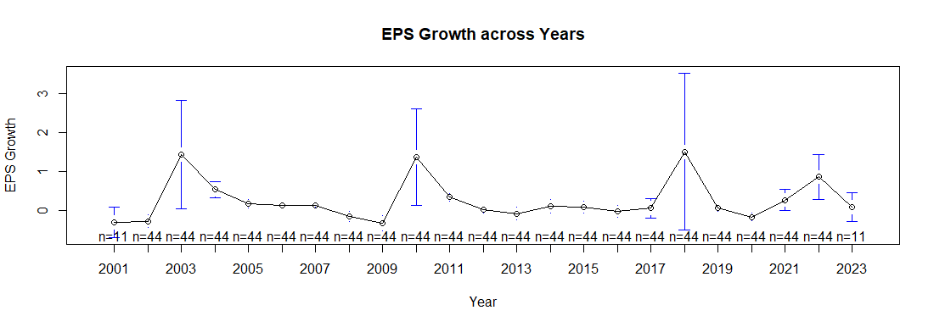
Exploratory Data Analysis (Seasonal Trend)
Recession observed in 2001, 2009, 2017 and 2020, therefore created a dummy variable for the same.

Slide 11
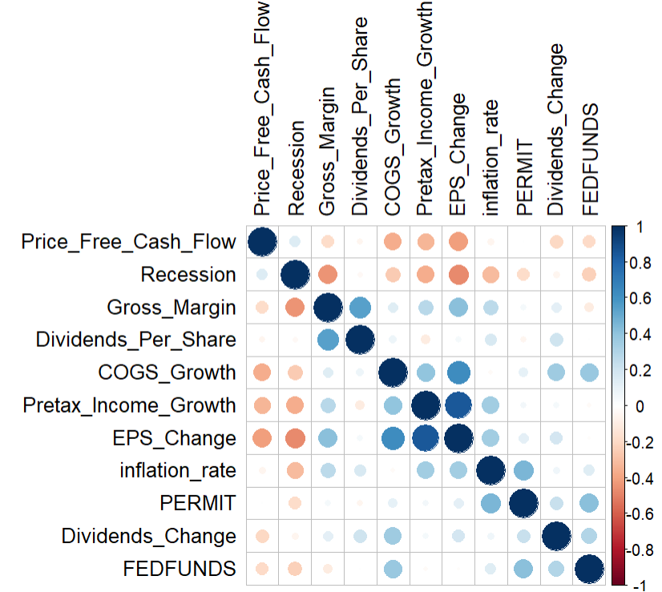
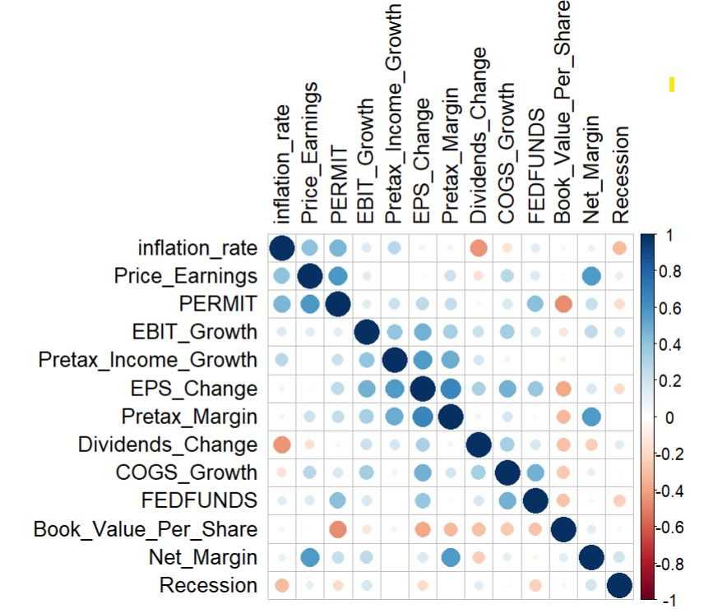
Exploratory Data Analysis (Correlations)
Correlation Coefficient Cut off = 0.7
Correlation plot for the Materials Sector
Correlation plot for Consumer Staples Sector
Notes:
Correlation Plots provides p-values and confidence intervals to help us determine the statistical significance of the correlations. The stronger the color and the bigger the size, the higher the correlation.
The stronger the correlation, the more difficult it is to change one variable without changing another. It becomes difficult for the model to estimate the relationship between each independent variable and the dependent variable independently because the independent variables tend to change in unison.
Corrplot for Materials
The correlation plot shows the variables that do not have more than an absolute value of 0.7 as the correlation coefficient. A combination of these variables are used for the modelling.
Corrplot for Consumer Staples
The correlation plot shows the variables that do not have more than an absolute value of 0.7 as the correlation coefficient. A combination of these variables are used for the modelling.

Slide 12
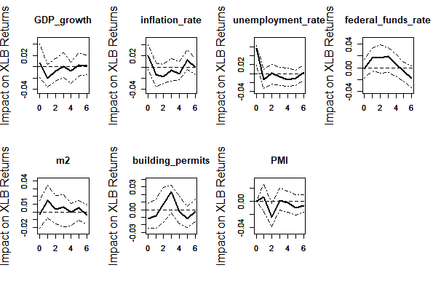
Exploratory Data Analysis (VaR & Macro analysis)
Macro plot for Materials Sector
Notes:
The Vector Autoregression (VAR) model is being used to analyze the impact of several macroeconomic variables on the returns of ETFs, which is an exchange-traded fund that tracks different sectors of the U.S. stock market. In this context, the VAR model is used to estimate how changes in GDP growth, inflation rate, unemployment rate, federal funds rate, M2 money stock, building permits, and Purchasing Managers' Index (PMI) affect the returns of the ETF. After fitting the VAR model, Impulse Response Functions (IRFs) are plotted for each macroeconomic variable on an ETF’s returns.
The plots present the estimated impact on an ETF’s returns (y- axis) over the next six quarters (x-axis) following a one standard deviation increase in the corresponding macroeconomic variable. The solid line in the middle is the estimated impact, while the dashed lines above and below represent the upper and lower bounds of a 95% confidence interval for this estimate. If the interval contains zero, it indicates that the impact is not statistically significant at the 5% level.
Macro Plot for Materials
In this plot, we can see the effects of 7 different macroeconomic leading indicators on the Materials sector ETF. This has been determined through the data from the ETF data on Yahoo Finance. We can determine from the plot that the variables that highly effect this ETF are:
Federal funds rate
Building Permits
Money Stock (m2)
These 3 variables are used to determine the difference in forecasts and whether they help in improving the earnings forecast or not.

Slide 13
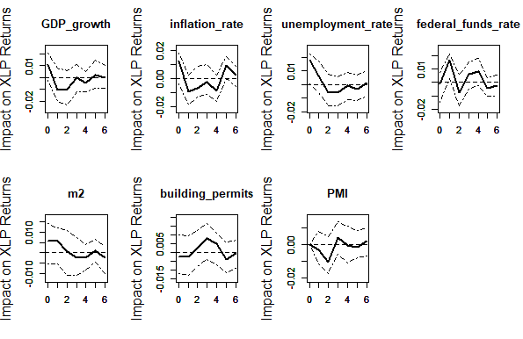
Exploratory Data Analysis (VaR & Macro analysis)
Macro plot for Consumer Staples Sector
Notes:
Macro Plot for Consumer Staples
In this plot, we can see the effects of 7 different macroeconomic leading indicators on the Consumer Staples sector ETF. This has been determined through the data from the ETF data on Yahoo Finance. We can determine from the plot that the variables that highly effect this ETF are:
Federal funds rate
Building Permits
These 2 variables are used to determine the difference in forecasts and whether they help in improving the earnings forecast or not.

Slide 14
Agenda
Business Understanding
Data Understanding/Preparation
Exploratory Data Analysis
Modeling
Evaluation/Results

Slide 15
Modeling (Time-Series)
Time Series Linear Regression
Dynamic Linear Regression
Notes:
We attempted various models. First tried the basic linear regression to understand the nature of the variables’ behavior and then moved on to the time-series linear regression model, VaR model, dynamic linear regression model, moving average model, ARIMA model among others. Eventually made use of time-series linear regression and dynamic linear regression with time-series data for the modeling since ARIMA and Moving Average are used for univariate time-series.
We attempted modeling on both quarterly and annual data, and eventually went for annual forecasting on Time-Series Linear Regression model since we had to compare our forecasts with those of the analysts and their forecasts were annual. But for Dynamic Linear Regression model, we used quarterly data for more predicted value and better visualization.

Slide 16
Time – Series Linear Regression Modeling
Data
Train Set: Data from 2001 to 2019
Test Set: Data from 2020 to 2022
Dependent Variable: EPS Growth
Independent Variables: Variables from the correlation plot
Model
Time-series linear regression
Forecasting the EPS Growth over the years.
Find the best model according to in-sample and out-of-sample accuracy
Using forecasted EPS growth find the forecasted EPS for the particular year
Notes:
In the time-series regression model, we divided the data into a training set and a test set. The training set consisted of data of the particular ETF from 2001 to 2019 and the test set consisted of data from 2020 to 2022. For this model, we have considered EPS Growth to be the dependent variable that we are supposed to forecast and the independent variables we will consider are the ones that we will get from the correlation plot during the EDA. We then use different variations of independent variables to find the best-fitted model. We also use the recession variable as an independent variable for forecasting.
We do this modeling twice:
Once by using the macroeconomic leading indicators that we obtained from the macro plots in the EDA
Second model will be without the macroeconomic leading indicators to compare the results with that of the one with macro indicators and check if the model with macros does better than the one without or not.
To find the best-fitted model we use both in-sample and out-of-sample accuracy.
In-sample accuracy determines how good the model is on the training data and consists of CV, AIC, BIC, etc wherein the lower the value of these the better the model
Out-of-sample accuracy determines how good the model is on the test data and consists of Mean Error, Root Mean Square Error, etc wherein the lower the value of these the better the model. For R square, the closer the model is to 1 the better the model.
We will consider 2 sectors to examine the results (Materials and Consumer Staples). One is beating the forecasts of the analysts and the forecasts of the model without macro data and the second is beating the forecasts of the analysts but not the forecasts of the model without macro data.

Slide 17
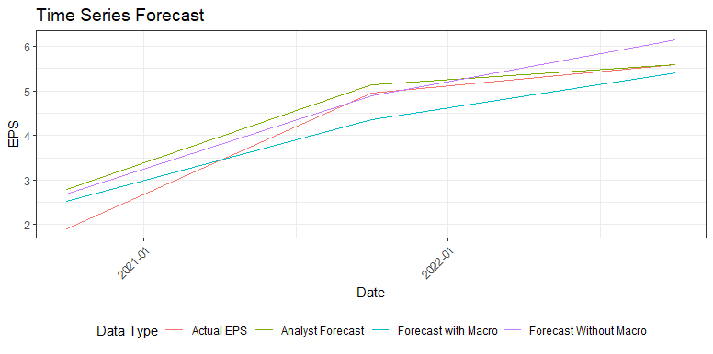
Time – Series Linear Regression Modeling (Materials)
Notes:
This graph shows the earnings per share of firms in the Materials sector from 2020 to 2022 along with the relationship between the different metrics which are:
The actual EPS data which is shown by the red line
The forecasts of the analysts which are shown by the green line
Our forecasts by including the macroeconomic indicators in the model which is shown by the blue line
Our forecasts by excluding the macroeconomic indicators in the model which is shown by the purple line

Slide 18
Time – Series Linear Regression Modeling (Materials)
In-sample and Out-of-sample accuracy metrics of models
With Macro​
In Sample Accuracy​ |  |  |  |  | Out of Sample Accuracy​
CV​ | AIC​ | AICc​ | BIC​ | AdjR2​ | ME​ | RMSE​ | MAE​ | MPE​ | MAPE​
0.223​ | -34.085​ | 3.629​ | -23.696​ | 0.582​ | 0.055​ | 0.502​ | 0.464​ | -5.629​ | 15.821​
Forecasts of analysts​
ME​ | RMSE​ | MAE​ | MPE​ | MAPE​
-0.353​ | 0.519​ | 0.356​ | -16.598​ | 16.638​
Without Macro​
In Sample Accuracy​ |  |  |  |  | Out of Sample Accuracy​
CV​ | AIC​ | AICc​ | BIC​ | AdjR2​ | ME​ | RMSE​ | MAE​ | MPE​ | MAPE​
0.136​ | -39.947​ | -25.547​ | -32.392​ | 0.684​ | -0.425​ | 0.554​ | 0.466​ | -16.556​ | 17.392​
Notes:
The table below shows the in-sample and out-of-sample accuracy of the model with the macroeconomic data and without macroeconomic data. We have the out-of-sample accuracy for the forecasts of the analyst. We have calculated these measures with respect to the actual EPS data to see how closely we have modeled the data.

Slide 19
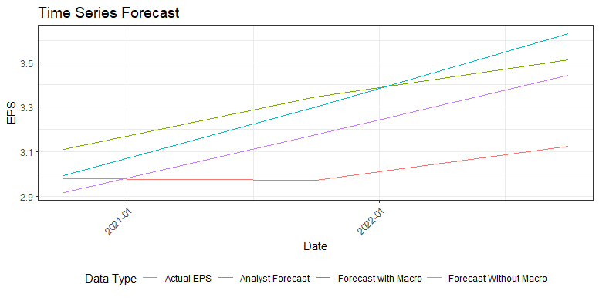
Time – Series Linear Regression Modeling (Consumer Staples)
Notes:
This graph shows the earnings per share of firms in the Consumer Staples sector from 2020 to 2022 along with the relationship between the different metrics which are:
The actual EPS data which is shown by the red line
The forecasts of the analysts which are shown by the green line
Our forecasts by including the macroeconomic indicators in the model which is shown by the blue line
Our forecasts by excluding the macroeconomic indicators in the model which is shown by the purple line
The table below shows the in-sample and out-of-sample accuracy of the model with the macroeconomic data and without macroeconomic data. We have the out-of-sample accuracy for the forecasts of the analyst. We have calculated these measures with respect to the actual EPS data to see how closely we have modeled the data.
Through this graph and the table, we can see that our model with macroeconomic variables is performing better than the the forecasts of the analysts but not outperforming the model without macroeconomic factors. It shows a lower mean error and RMSE as compared to the accuracy of the model without the macro variables while comparing it to the actual EPS data.

Slide 20
Time – Series Linear Regression Modeling (Consumer Staples)
In-sample and Out-of-sample accuracy metrics of models
With Macro​
In Sample Accuracy​ |  |  |  |  | Out of Sample Accuracy​
CV​ | AIC​ | AICc​ | BIC​ | AdjR2​ | ME​ | RMSE​ | MAE​ | MPE​ | MAPE​
0.007​ | -115.930​ | -78.216​ | -105.541​ | 0.548​ | -0.282​ | 0.348​ | 0.282​ | -9.219​ | 9.219​
Forecasts of analysts​
ME​ | RMSE​ | MAE​ | MPE​ | MAPE​
-0.298​ | 0.320​ | 0.298​ | -9.801​ | 9.801​
Without Macro​
In Sample Accuracy​ |  |  |  |  | Out of Sample Accuracy​
CV​ | AIC​ | AICc​ | BIC​ | AdjR2​ | ME​ | RMSE​ | MAE​ | MPE​ | MAPE​
0.006​ | -117.295​ | -97.295​ | -108.795​ | 0.576​ | -0.153​ | 0.221​ | 0.195​ | -4.971​ | 6.395​
Notes:
The table below shows the in-sample and out-of-sample accuracy of the model with the macroeconomic data and without macroeconomic data. We have the out-of-sample accuracy for the forecasts of the analyst. We have calculated these measures with respect to the actual EPS data to see how closely we have modeled the data.
Through this graph and the table, we can see that our model with macroeconomic variables is performing better than the the forecasts of the analysts but not outperforming the model without macroeconomic factors. It shows a lower mean error and RMSE as compared to the accuracy of the model without the macro variables while comparing it to the actual EPS data.

Slide 21
Time – Series Dynamic Linear Regression Modeling
Data
Train Set: Data from 2001 Q4 to 2019 Q4
Test Set: Data from 2020 Q1 to 2023 Q1
Dependent Variable: EPS Growth
Independent Variables: Variables from the correlation plot
Model
Dynamic Linear Regression
Forecasting the EPS Growth over the years.
Find the best model according to in-sample and out-of-sample accuracy
Notes:
Additional to the time-series linear regression model, we use another time-series model: Time-Series Dynamic Linear Regression Models. In this model, we also divided the data into a training set and a test set. The training set consisted of data of the particular ETF from 2001 Q4 to 2019 Q4 and the test set consisted of data from 2020 Q1 to 2023 Q1. Just same as the previous tslm model, for this model, we still considered EPS Growth to be the dependent variable that we are supposed to forecast and the independent variables we will consider are the ones that we will get from the correlation plot during the EDA. We then use different variations of independent variables to find the best-fitted model.
Again, We do this modeling twice:
Once by using the macroeconomic leading indicators that we obtained from the macro plots in the EDA
Second model will be without the macroeconomic leading indicators to compare the results with that of the one with macro indicators and check if the model with macros does better than the one without or not.
Then, We do the previous TSLM model again to compare it with DYNLM model to check which model works better.
To find the best-fitted model we use both in-sample and out-of-sample accuracy as previous models mentioned.
In this part, We will consider another 2 sectors to examine the results (Healthcare and Consumer Discretionary) and mainly use Healthcare sector as an example. In the TSLM Model for Healthcare sector, it has already had a better forecast than analyst, but it had a bad forecast when adding the macroeconomics leading indicators. After doing the DYNLM model for this sector, the model has a better accuracy than TSLM model, and the model works better when adding macro leading indicators.

Slide 22
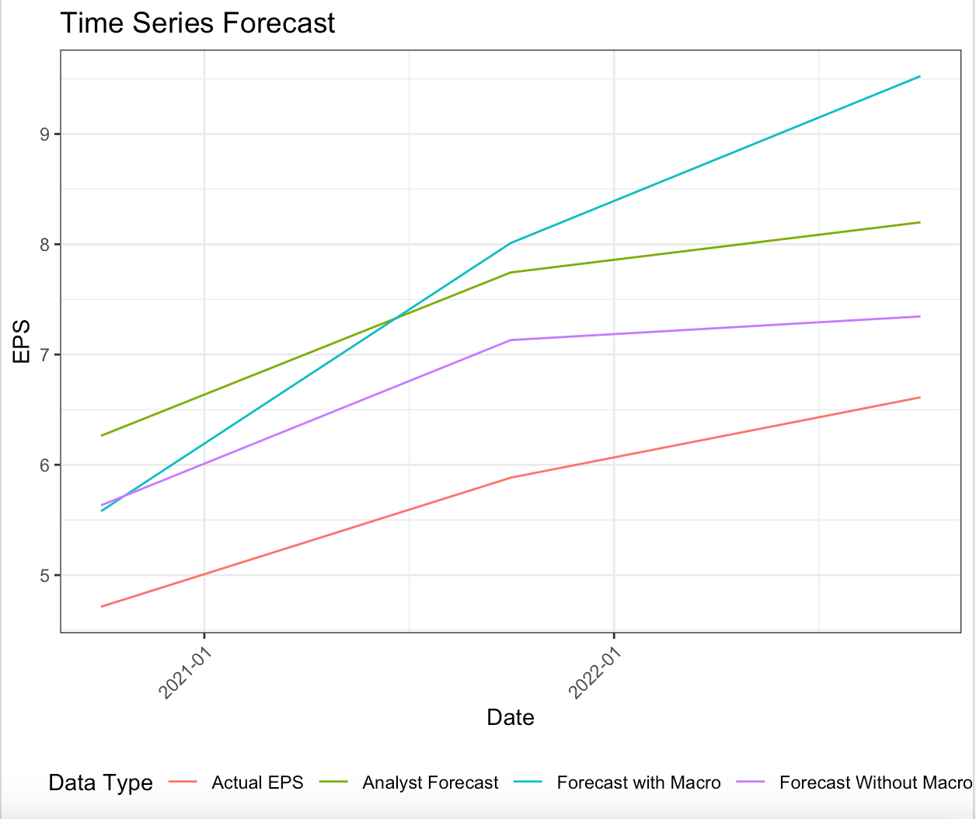
Time – Series Dynamic Linear Regression Modeling
Time-series Linear regression for Healthcare Sector:
Beat the analyst ☑️
A good model for all sectors ❓
Macro Data works ✖️
New Model: Dynamic Linear Regression Model
Notes:
As you can see in this graph, it shows the EPS of firms in the Healthcare sector from 2020 to 2022 along with the relationship between the different metrics which are:
The actual EPS data which is shown by the red line
The forecasts of the analysts which are shown by the green line
Our forecasts by including the macroeconomic indicators in the model which is shown by the blue line
Our forecasts by excluding the macroeconomic indicators in the model which is shown by the purple line
It is clearly seen that our model has beaten the analyst's forecast. But adding the macro indicators to the model does not work on Healthcare Sector. Also, for different sectors, we may use different models for a better forecast. Then it comes to a new time-series model: dynamic linear regression model.

Slide 23
Time – Series Dynamic Linear Regression Modeling
Difference from Time-series linear model:
Change the annually data to quarterly data for more predicted value.
Using EPS change as the dependent variable instead of real EPS for convenience.
Remove some of variables with high p-value after correlation plot.
Notes:
Dynamic Linear Regression model is a time series forecasting technique that extends the classical linear regression model by incorporating time series components such as trends, seasonal patterns, and autoregressive effects.
This model is based on the idea that the current value of a time series can be predicted as a linear combination of its past values and the past values of other related time series. The model assumes that the coefficients of the linear combination are time-varying and can be estimated using maximum likelihood estimation. Here we use this model to make point forecast for the EPS_Change.
Different from TSLM model, we make some changes here to do the DYNLM model.
We change the annually data to quarterly data. Since for the Healthcare sector, we have already beaten the analyst's forecast, the only thing here we need is to improve to do a more accurate model. Thus here we do not need to do annually data anymore for comparing it to the analyst's model. And quarterly data has more predicted values and a better visualization on the graph. So we used quarterly data instead of annually data in DYNLM model.
We still use EPS change as the dependent variable, but this time we do not use the formula to compute back for real EPS. Since again, we do not need to compare our forecast with the analyst's, so we just use EPS_Change to test the accuracy of the DYNLM model for convenience.
Also, we not only used correlation plot, and remove some of variables with not significant p-value and try many different combinations of variables for a better forecast.

Slide 24
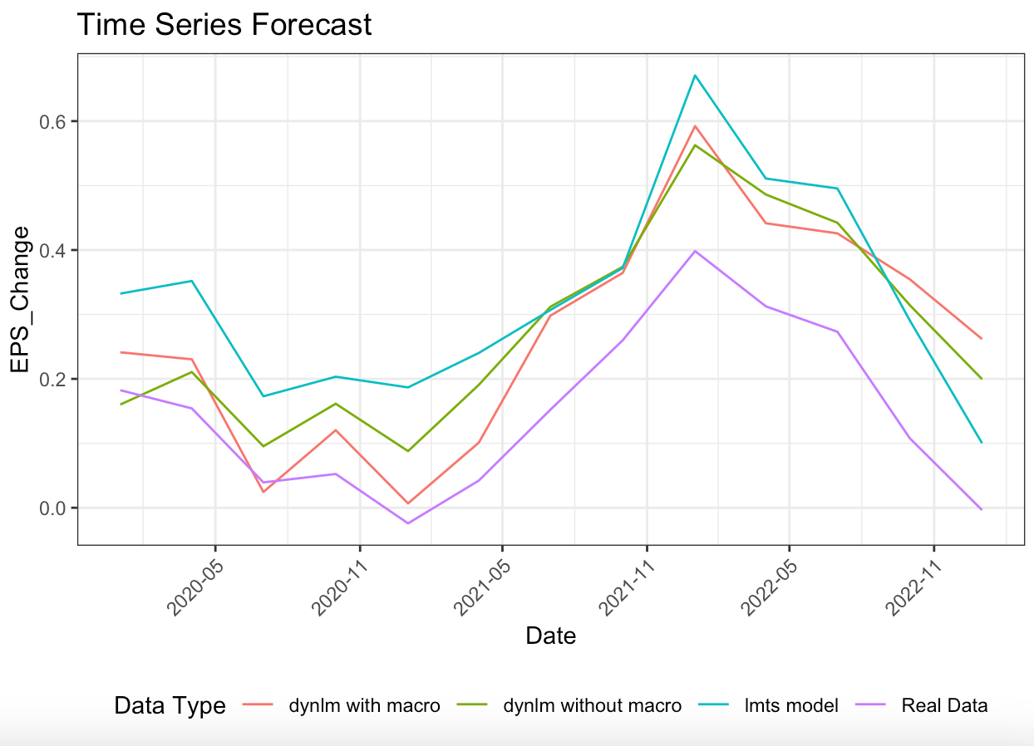
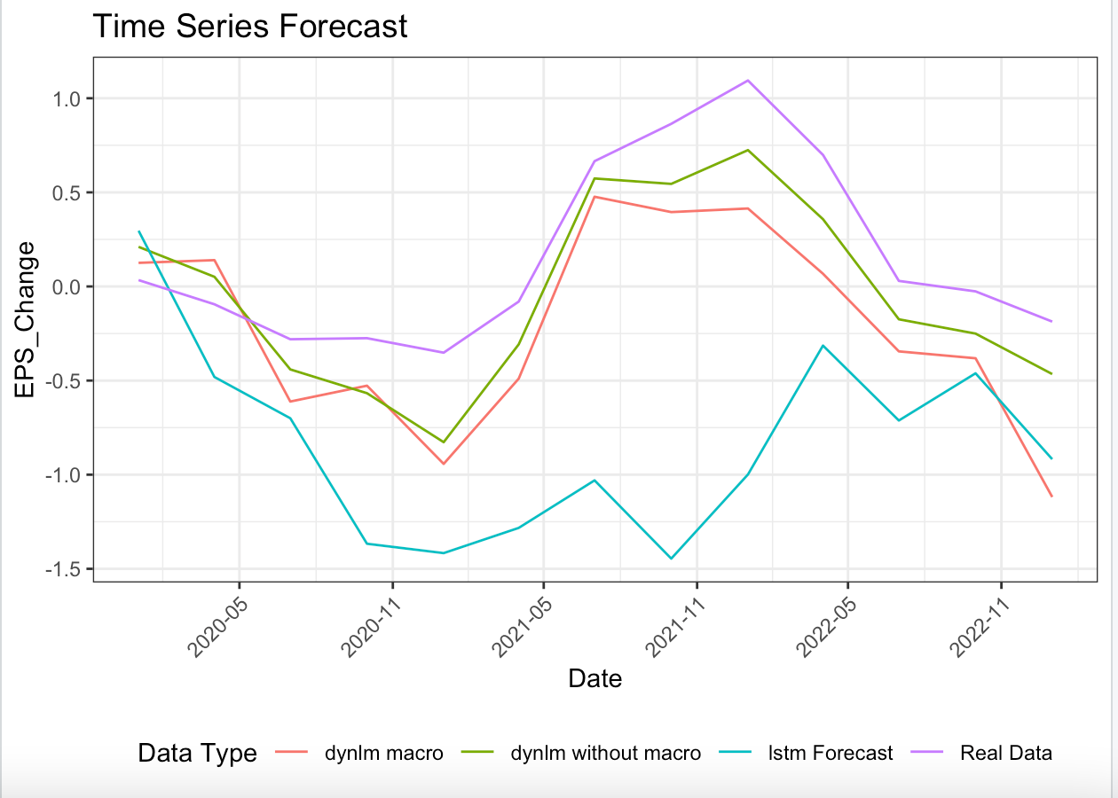
Time – Series Dynamic Linear Regression Modeling (Healthcare & Consumer Discretionary Sector)
Notes:
In the left of the graph is the results of dynamic linear regression model for Healthcare Sector, and on the right it’s the Consumer Discretionary Sector. As you can see in this graph, it shows the EPS change of sectors from 2020 Q1 to 2023 Q1 along with the relationship between the different metrics which are:
The real data (EPS change) is shown by purple line
The previous TSLM model’s forecast is shown by blue line
The new DYNLM model’s forecast without marco data is shown by green line.
The new DYNLM model’s forecast with macro data is shown by red line.
We can get the conclusion just from this graph that the DYNLM model has a good forecast of EPS_Change on trend with the actual data. And on both of these two sectors, DYNLM model works better than the previous TSLM model with a lower mean absolute error. Also, in Healthcare sector, model with the macro data predicts better than model without macro data, which means macro data works on TSLM model. However, for the Consumer Discretionary Sector, the DYNLM model without macro still performs better than model with macro data. It is probably that we still haven’t found the most suitable macro leading indicators for this certain sector.

Slide 25
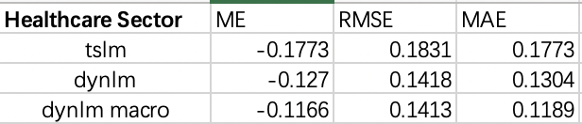
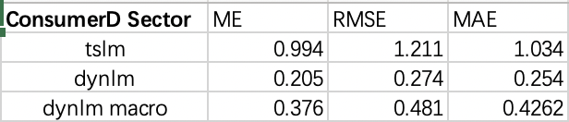
Time – Series Dynamic Linear Regression Modeling
Accuracy between tslm model and dynlm model
(Healthcare & Consumer Discretionary Sector)
Notes:
Lastly, we use the “accuracy”function in R to test the model. As you can see from the table above, the mean absolute error for both sectors improve from using TSLM model to using DYNLM model, which means the forecast for EPS Change has fewer error with the actual EPS Change. Also, the Consumer Discretionary Sector improves more when using DYNLM model.
Therefore, we made the conclusion that for different sectors, we may use different models for a better forecast. Also, in Healthcare Sector, we use the Macro data of “FEDFUNDS”, “Permit”, “NMI” and “PMI”, and in Consumer Discretionary Sectors, we use the Macro data of “FEDFUNDS”,“inflation_rate”, “PMI” and “Recession”. So different macro indicators also has different impacts on modelling.

Slide 26

Evaluation/Results

Slide 27
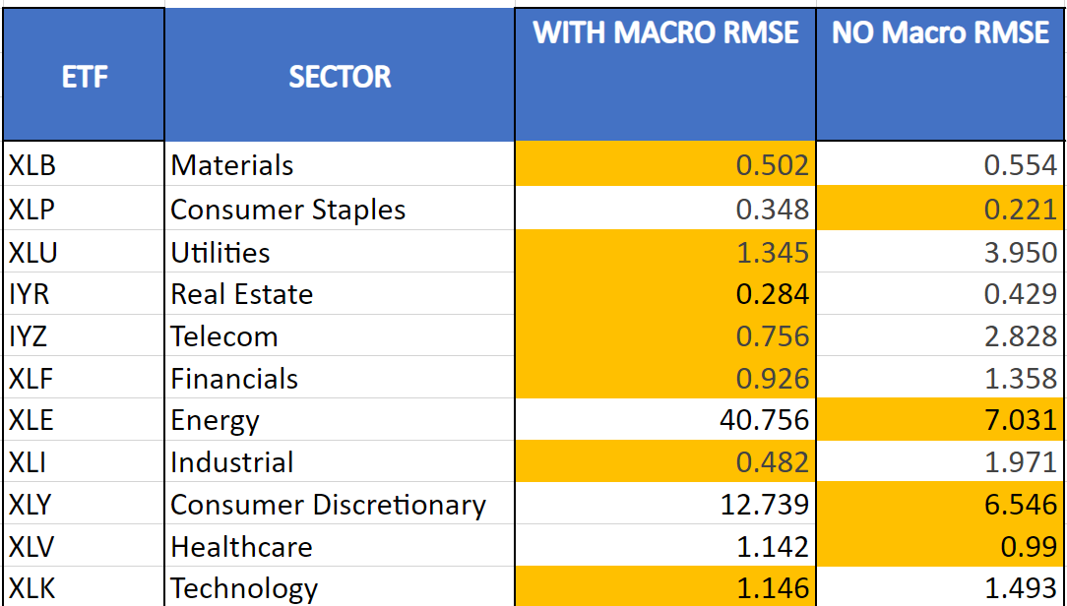
Comparing Accuracy modelling with Macro Variables against modelling with no Macro Variables
7OUT OF 11 Sector models with macro variables had a higher accuracy
Root Mean Square Error(RMSE)- The closer the RMSE is to the zero the better the accuracy
Notes:
We found RMSE useful because it penalizes large errors more than small errors. It is also in the same units as the target variable, which makes it easier to interpret. Generally, a lower RMSE indicates better model performance

Slide 28
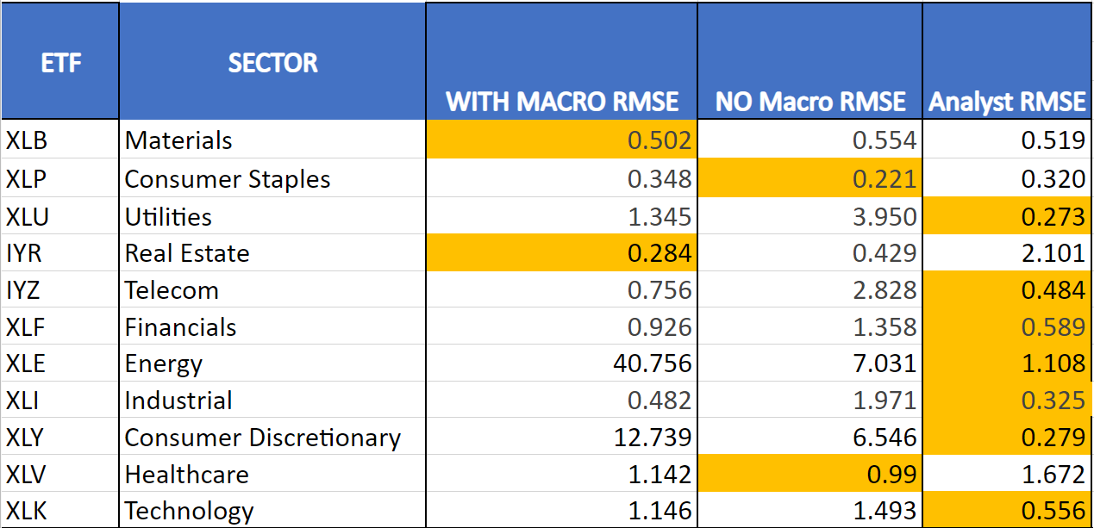
Accuracy of Our Forecast against the Forecast of Other Analysts
4 OUT OF 11 Sector models with beat the forecasts of analysts in terms of accuracy
Root Mean Square Error(RMSE)- The close the RMSE is to the zero the better the accuracy

Slide 29
Limitations of Models
Used data for 20 years only
Only made use of 8 leading indicators for analysis
Made assumptions that the accuracies used determine the best model

Slide 30
Conclusion
Time series models such as linear regression and dynamic linear regression depicted the best models.
Forecasts of most of the sector earnings were improved in terms of accuracy when leading indicators were tailored to suit the earnings of the sectors.
Having IRF (impulse response) graphs can help save time on research. In this way, an analyst can gauge which macroeconomic variables greatly affect an ETF or stock the most and focus primarily on that instead of other variables that won't have as big an impact on returns.

Slide 31
Thank You

Slide 32
Appendix: Data Mining
Compustat
Used PostGre SQL to extract earnings data for small cap firms from Compustat through R to get the data for actual EPS for various sectors.
Realised that the earnings value in Compustat don’t match those of IBES and IBES is more reliable for data, therefore disregarded this option.
IBES
Used PostGre SQL to extract forecasted earnings data for small cap firms from IBES through R for various sectors.
Realised that the data was misleading and unreliable since it didn’t have unique IDs and very high EPS for small cap firms which isn’t possible. Therefore disregarded this option as well.
Notes:
Data Mining
We started by initially researching small-cap firms for a sector each. We eventually realized that the information may not be cohesive if we only choose particular sectors and only a few firms in it. We may not be able to accurately predict the earnings. Therefore we decided to get all the data on small-cap firms for all the sectors.
In order to capture the data, we decided to use net income initially to predict the earnings and capture the data from the Compustat database but there were some discrepancies with the data.
We then decided to use earnings per share to model the earnings of small-cap firms. We queried the data from Compustat using Postgre SQL and subsequently filtered out firms that were small-cap. We then mapped the sectors to the data and cleaned the data. After some analysis we realised that Compustat data doesn’t match IBES data from where we were going to capture the analysts forecast. Therefore we decided to use IBES to query data instead.
We used IBES to query data through Postgre SQL and filtered the small-cap firms along with mapping to various sectors. In this data we realised that the some companies do not have unique IDs and some companies have unrealistic EPS values (in billions). Therefore we decided to disregard IBES as well and that’s when we move to Factset where we could easily download Sector ETF data for both actuals and forecasts.

Slide 33
Appendix: Modeling
Models tried but didn't work:
ARIMA model
Moving Average model
Linear Regression without time-series
Linear Regression with interactions
Notes:
We started initially with a basic linear model, but we realised that it wont work since our data is financial data with time-series and hence we will require a model that understands trends and seasons as well. Therefore we used time-series based models.
The model that we used first was time-series linear regression model that worked.
The ARIMA model and the Moving average model didn't work since the data was not univariate time-series and depended on multiple other independent variables.

Slide 34
Time – Series Linear Regression Modeling (Quarterly)
Data
Train Set: Data from 2001 Q4 to 2019 Q4
Test Set: Data from 2020 Q1 to 2023 Q1
Dependent Variable: EPS Growth
Independent Variables: Variables from the correlation plot
Model
Time-series linear regression
Forecasting the EPS Growth over the years.
Find the best model according to in-sample and out-of-sample accuracy
Notes:
In the time-series regression model, we divided the data into a training set and a test set. The training set consisted of data of the particular ETF from 2001 to 2019 and the test set consisted of data from 2020 to 2022. For this model, we have considered EPS Growth to be the dependent variable that we are supposed to forecast and the independent variables we will consider are the ones that we will get from the correlation plot during the EDA and the macroeconomic variables from the IRF plots. We then use different variations of independent variables to find the best-fitted model. We also use the recession variable as an independent variable for forecasting.
To find the best-fitted model we use both in-sample and out-of-sample accuracy.
In-sample accuracy determines how good the model is on the training data and consists of CV, AIC, BIC, etc wherein the lower the value of these the better the model
Out-of-sample accuracy determines how good the model is on the test data and consists of Mean Error, Root Mean Square Error, etc wherein the lower the value of these the better the model. For R square, the closer the model is to 1 the better the model.
We will consider 2 sectors to examine the results (Materials and Consumer Staples). One is beating the forecasts of the analysts and the forecasts of the model without macro data and the second is beating the forecasts of the analysts but not the forecasts of the model without macro data.

Slide 35
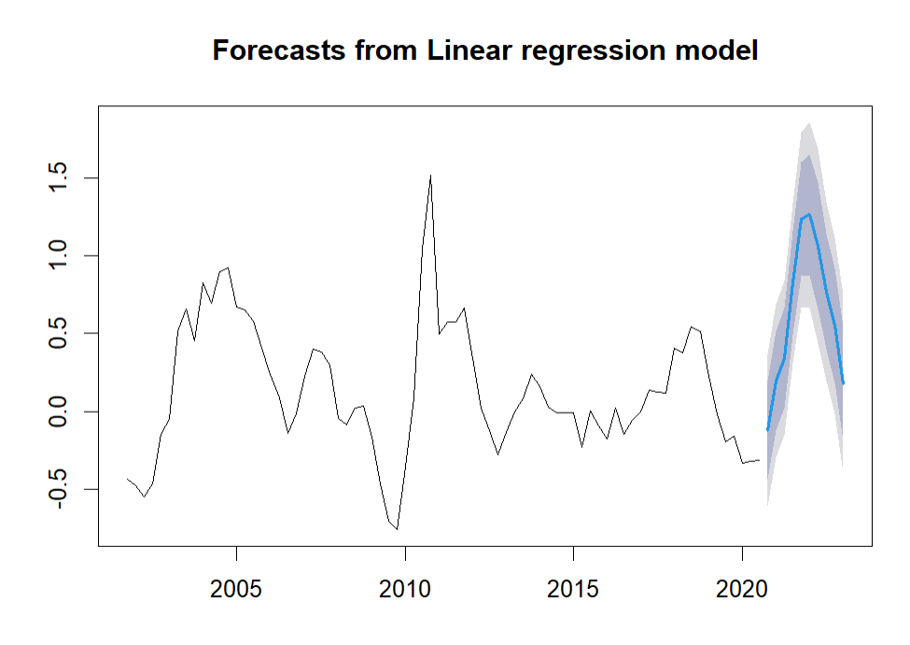
Time – Series Linear Regression Modeling (Quarterly)
Notes:
This graph shows the forecasts of the EPS growth. The solid black line shows the actual EPS growth from the years 2001 to 2019. The solid blue line shows the forecasts from 2020 to 2023. The shaded regions show the 80% and 95% confidence intervals respectively. We can see here there was a dip in the EPS growth in 2020 and then it jumped in 2021 which is mostly described because of covid.

Slide 36
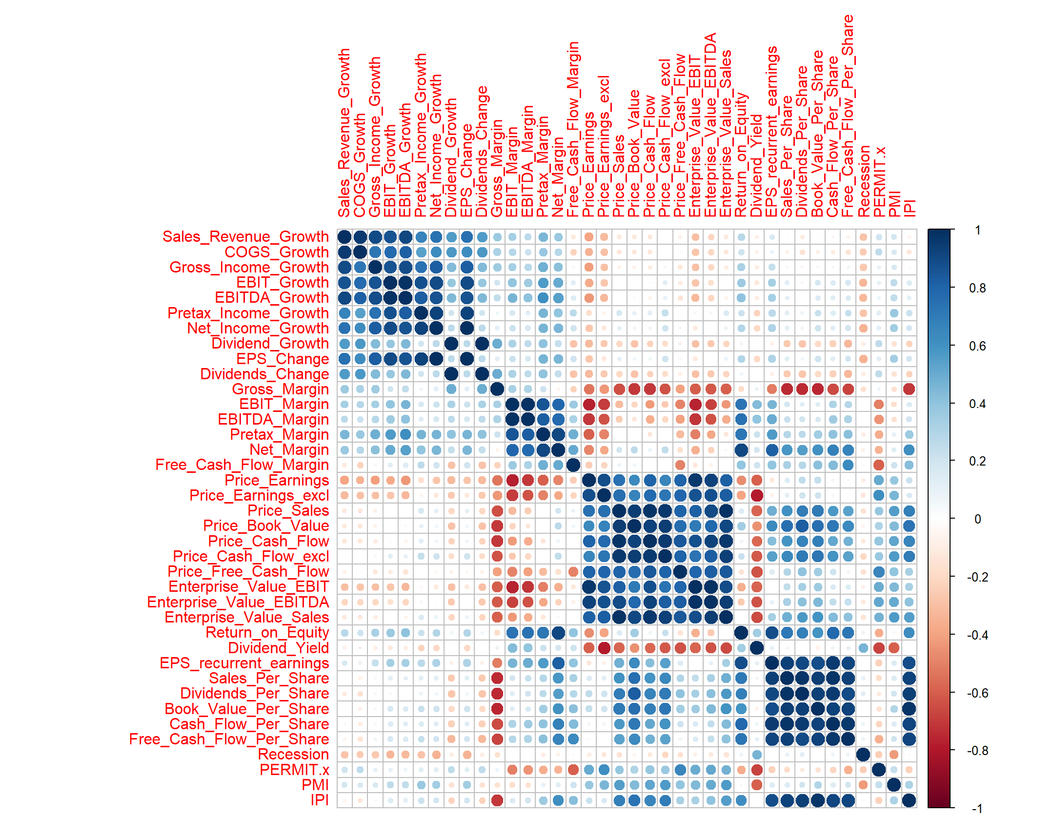
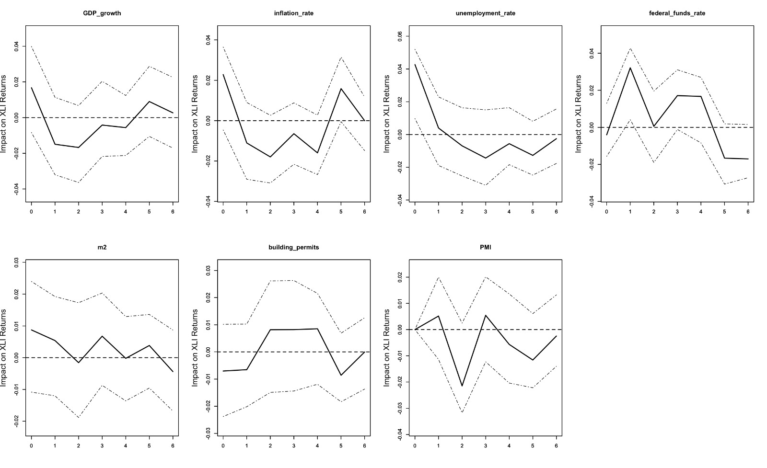
Appendix: EPS Change against leading Indicators for Industrials (EDA)
Macro plot describing the leading indicators showing effect on the sector.
Correlation plot with all correlations.
Notes:
Macro Plot
In this plot, we can see the effects of 7 different macroeconomic leading indicators on the Industrials sector ETF. This has been determined through the data from the ETF data on Yahoo Finance. We can determine from the plot that the variables that highly effect this ETF are:
Federal funds rate
Money Stock (m2)
Building Permits
These 3 variables are used to determine the difference in forecasts and whether they help in improving the earnings forecast or not.
Corrplot
The correlation plot shows the correlation of all variables but we are considering the variables that do not have more than an absolute value of 0.7 as the correlation coefficient. A combination of these variables is used for the modeling.

Slide 37
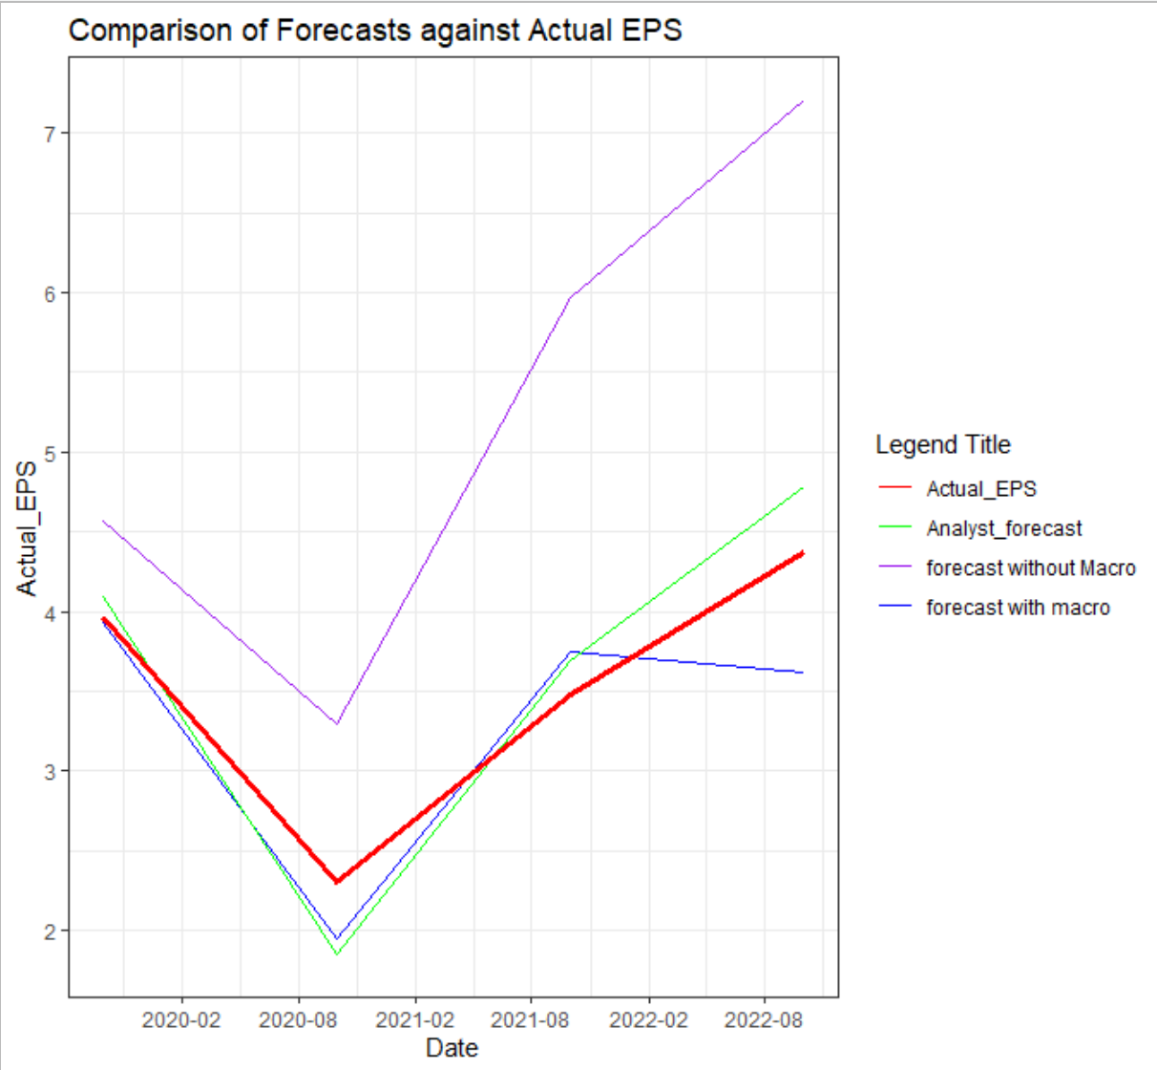
Time – Series Linear Regression Modeling (Industrial)
LEADING INDICATORS USED to model
IPI
PMI
Notes:
This graph shows the earnings per share of firms in the Industrial sector from 2019 to 2022 along with the relationship between the different metrics which are:
The actual EPS data which is shown by the red line
The forecasts of the analysts which are shown by the green line
Our forecasts by including the macroeconomic indicators in the model which is shown by the blue line
Our forecasts by excluding the macroeconomic indicators in the model which is shown by the purple line
The table below shows the in-sample and out-of-sample accuracy of the model with the macroeconomic data and without macroeconomic data. We have the out-of-sample accuracy for the forecasts of the analyst. We have calculated these measures with respect to the actual EPS data to see how closely we have modeled the data.
Forecast with macro with MAE of 0.36 is much better than the one without macro and came close to beat the forecast of analyst with an MAE 0.29.

Slide 38
Appendix: Industrial (Modeling)
With Macro​
In Sample Accuracy​ |  |  |  |  | Out of Sample Accuracy​
CV​ | AIC​ | AICc​ | BIC​ | AdjR2​ | ME​ | RMSE​ | MAE​ | MPE​ | MAPE​
0.058​ | -76.301​ | 12.747​ | -66.678​ | 0.812​ | 0.257​ | 0.482​ | 0.353​ | 7.187​ | 10.291​
Forecasts of analysts​
ME​ | RMSE​ | MAE​ | MPE​ | MAPE​
0.073​ | 0.325​ | 0.297​ | 0.265​ | 9.494​
Without Macro​
In Sample Accuracy​ |  |  |  |  | Out of Sample Accuracy​
CV​ | AIC​ | AICc​ | BIC​ | AdjR2​ | ME​ | RMSE​ | MAE​ | MPE​ | MAPE​
0.075​ | -73.675​ | -42.247​ | -64.771​ | 0.775​ | -1.729​ | 1.971​ | 1.729​ | 48.697​ | 48.697​
Notes:
The table below shows the in-sample and out-of-sample accuracy of the model with the macroeconomic data and without macroeconomic data. We have the out-of-sample accuracy for the forecasts of the analyst. We have calculated these measures with respect to the actual EPS data to see how closely we have modeled the data.
Through this graph and the table, we can see that our model with macroeconomic variables is performing better than the model without macroeconomic factors but it is almost comparable or less comparable than the forecasts of the analysts. They show a lower mean error and RMSE as well while comparing it to the actual EPS data.

Slide 39
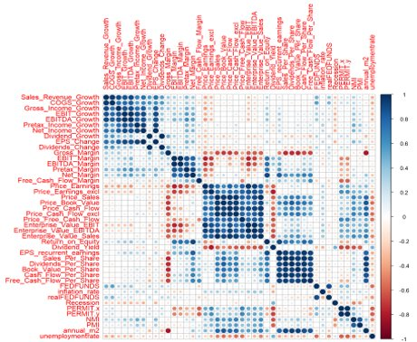
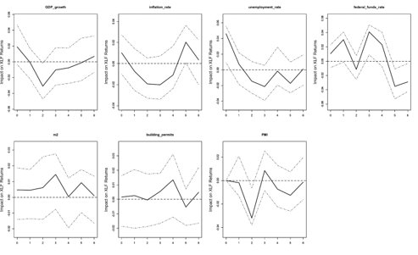
Appendix: EPS Change against leading Indicators for Financials (EDA)
Macro plot describing the leading indicators showing effect on the sector.
Correlation plot with all correlations.
Notes:
Macro Plot
In this plot, we can see the effects of 7 different macroeconomic leading indicators on the Industrials sector ETF. This has been determined through the data from the ETF data on Yahoo Finance. We can determine from the plot that the variables that highly effect this ETF are:
Federal funds rate
Money Stock (m2)
Building Permits
These 3 variables are used to determine the difference in forecasts and whether they help in improving the earnings forecast or not.
Corrplot
The correlation plot shows the correlation of all variables but we are considering the variables that do not have more than an absolute value of 0.7 as the correlation coefficient. A combination of these variables is used for the modeling.

Slide 40
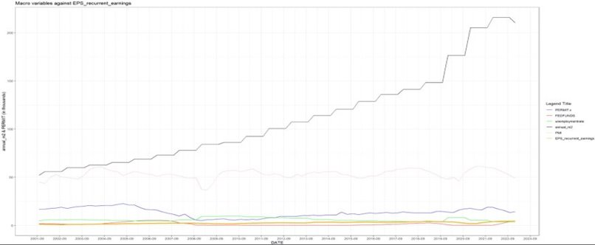
Appendix: EPS Change against leading Indicators for Financials (EDA)
Notes:
This graph shows the earnings per share of firms in the Financial sector from 2020 to 2022 along with the relationship between the different metrics which are:
The actual EPS data which is shown by the red line
The forecasts of the analysts which are shown by the green line
Our forecasts by including the macroeconomic indicators in the model which is shown by the blue line
Our forecasts by excluding the macroeconomic indicators in the model which is shown by the purple line
The table below shows the in-sample and out-of-sample accuracy of the model with the macroeconomic data and without macroeconomic data. We have the out-of-sample accuracy for the forecasts of the analyst. We have calculated these measures with respect to the actual EPS data to see how closely we have modeled the data.
Through this graph and the table, we can see that our model with macroeconomic variables is performing better than the model without macroeconomic factors but it is almost comparable or less comparable than the forecasts of the analysts. They show a lower mean error and RMSE as well while comparing it to the actual EPS data.

Slide 41
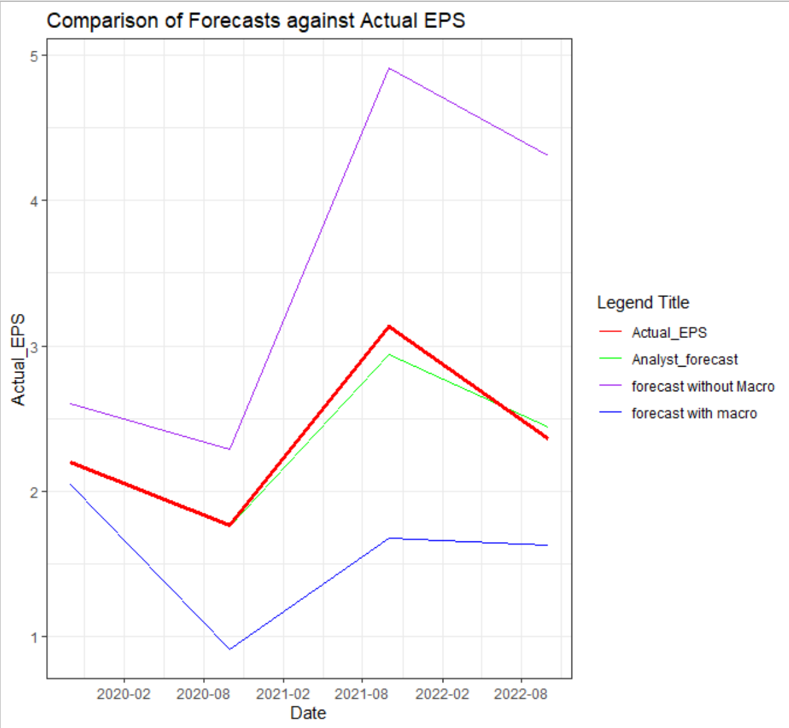
Time – Series Linear Regression Modeling (Financial)
LEADING INDICATORS USED to model
US TREASURY 10YR BONDS
Used only one macro variable in our data because it was the only leading indicator that had a significant impact on our dependent variable.
Notes:
This graph shows the earnings per share of firms in the Financial sector from 2019 to 2022 along with the relationship between the different metrics which are:
The actual EPS data which is shown by the red line
The forecasts of the analysts which are shown by the green line
Our forecasts by including the macroeconomic indicators in the model which is shown by the blue line
Our forecasts by excluding the macroeconomic indicators in the model which is shown by the purple line
The table below shows the in-sample and out-of-sample accuracy of the model with the macroeconomic data and without macroeconomic data. We have the out-of-sample accuracy for the forecasts of the analyst. We have calculated these measures with respect to the actual EPS data to see how closely we have modelled the data.
All other macro variables in our model had near zero correlation with the financial sector including :unemployment rate , money supply . Upon further research we realized we could use credit card rates and mortgage rate but couldn't because of time constraints.

Slide 42
Appendix: Financials (Modeling)
With Macro​
In Sample Accuracy​ |  |  |  |  | Out of Sample Accuracy​
CV​ | AIC​ | AICc​ | BIC​ | AdjR2​ | ME​ | RMSE​ | MAE​ | MPE​ | MAPE​
6.591​ | 1.818​ | 6.818​ | 6.270​ | 0.857​ | 0.802​ | 0.926​ | 0.802​ | 33.316​ | 33.316​
Forecasts of analysts​
ME​ | RMSE​ | MAE​ | MPE​ | MAPE​
0.033​ | 0.589​ | 0.509​ | -28.660​ | 28.660​
Without Macro​
In Sample Accuracy​ |  |  |  |  | Out of Sample Accuracy​
CV​ | AIC​ | AICc​ | BIC​ | AdjR2​ | ME​ | RMSE​ | MAE​ | MPE​ | MAPE​
6.535​ | 0.712​ | 3.789​ | 4.273​ | 0.860​ | -1.160​ | 1.358​ | 1.160​ | -46.698​ | 46.698​
Notes:
The table below shows the in-sample and out-of-sample accuracy of the model with the macroeconomic data and without macroeconomic data. We have the out-of-sample accuracy for the forecasts of the analyst. We have calculated these measures with respect to the actual EPS data to see how closely we have modeled the data.
Through this graph and the table, we can see that our model with macroeconomic variables is performing better than the model without macroeconomic factors but it is almost comparable or less comparable than the forecasts of the analysts. They show a lower mean error and RMSE as well while comparing it to the actual EPS data.

Slide 43
Appendix: Materials (EDA)
Macro plot describing the leading indicators showing effect on the sector.
Correlation plot with cut off 0.7
Notes:
Macro Plot
In this plot, we can see the effects of 7 different macroeconomic leading indicators on the Telecommunication sector ETF. This has been determined through the data from the ETF data on Yahoo Finance. We can determine from the plot that the variables that highly effect this ETF are:
Federal funds rate
Money Stock (m2)
Building Permits
These 3 variables are used to determine the difference in forecasts and whether they help in improving the earnings forecast or not.
Corrplot
The correlation plot shows the variables that do not have more than an absolute value of 0.7 as the correlation coefficient. A combination of these variables are used for the modelling.

Slide 44
Appendix: Materials (Modeling)
With Macro |  |  |  |  |  |  |  |  |  | Without Macro |  |  |  |  |  |  |  |  |  | Forecasts of analysts
In Sample Accuracy |  |  |  |  | Out of Sample Accuracy |  |  |  |  | In Sample Accuracy |  |  |  |  | Out of Sample Accuracy
CV | AIC | AICc | BIC | AdjR2 | ME | RMSE | MAE | MPE | MAPE | CV | AIC | AICc | BIC | AdjR2 | ME | RMSE | MAE | MPE | MAPE | ME | RMSE | MAE | MPE | MAPE
0.223 | -34.085 | 3.629 | -23.696 | 0.582 | 0.055 | 0.502 | 0.464 | -5.629 | 15.821 | 0.136 | -39.947 | -25.547 | -32.392 | 0.684 | -0.425 | 0.554 | 0.466 | -16.556 | 17.392 | -0.353 | 0.519 | 0.356 | -16.598 | 16.638
Notes:
This graph shows the earnings per share of firms in the Materials sector from 2020 to 2022 along with the relationship between the different metrics which are:
The actual EPS data which is shown by the red line
The forecasts of the analysts which are shown by the green line
Our forecasts by including the macroeconomic indicators in the model which is shown by the blue line
Our forecasts by excluding the macroeconomic indicators in the model which is shown by the purple line
The table below shows the in-sample and out-of-sample accuracy of the model with the macroeconomic data and without macroeconomic data. We have the out-of-sample accuracy for the forecasts of the analyst. We have calculated these measures with respect to the actual EPS data to see how closely we have modeled the data.
Through this graph and the table, we can see that our model with macroeconomic variables is performing better than the forecasts of the analysts and the model without macroeconomic factors. It shows a lower mean error and RMSE as compared to the accuracy of the model without the macro variables while comparing it to the actual EPS data.
Through this graph and the table, we can see that our model with macroeconomic variables is performing better than the model without macroeconomic factors and also the forecasts of the analysts. They show a lower mean error and RMSE as well while comparing it to the actual EPS data.

Slide 45
Appendix: Consumer Staples (EDA)
Macro plot describing the leading indicators showing effect on the sector.
Correlation plot with cut off 0.7
Notes:
Macro Plot
In this plot, we can see the effects of 7 different macroeconomic leading indicators on the Consumer Staples sector ETF. This has been determined through the data from the ETF data on Yahoo Finance. We can determine from the plot that the variables that highly effect this ETF are:
Federal funds rate
Building Permits
These 2 variables are used to determine the difference in forecasts and whether they help in improving the earnings forecast or not.
Corrplot
The correlation plot shows the variables that do not have more than an absolute value of 0.7 as the correlation coefficient. A combination of these variables are used for the modelling.

Slide 46
Appendix: Consumer Staples (Modeling)
With Macro |  |  |  |  |  |  |  |  |  | Without Macro |  |  |  |  |  |  |  |  |  | Forecasts of analysts
In Sample Accuracy |  |  |  |  | Out of Sample Accuracy |  |  |  |  | In Sample Accuracy |  |  |  |  | Out of Sample Accuracy
CV | AIC | AICc | BIC | AdjR2 | ME | RMSE | MAE | MPE | MAPE | CV | AIC | AICc | BIC | AdjR2 | ME | RMSE | MAE | MPE | MAPE | ME | RMSE | MAE | MPE | MAPE
0.007 | -115.930 | -78.216 | -105.541 | 0.548 | -0.282 | 0.348 | 0.282 | -9.219 | 9.219 | 0.006 | -117.295 | -97.295 | -108.795 | 0.576 | -0.153 | 0.221 | 0.195 | -4.971 | 6.395 | -0.298 | 0.320 | 0.298 | -9.801 | 9.801
Notes:
This graph shows the earnings per share of firms in the Consumer Staples sector from 2020 to 2022 along with the relationship between the different metrics which are:
The actual EPS data which is shown by the red line
The forecasts of the analysts which are shown by the green line
Our forecasts by including the macroeconomic indicators in the model which is shown by the blue line
Our forecasts by excluding the macroeconomic indicators in the model which is shown by the purple line
The table below shows the in-sample and out-of-sample accuracy of the model with the macroeconomic data and without macroeconomic data. We have the out-of-sample accuracy for the forecasts of the analyst. We have calculated these measures with respect to the actual EPS data to see how closely we have modeled the data.
Through this graph and the table, we can see that our model with macroeconomic variables is performing better than the the forecasts of the analysts but not outperforming the model without macroeconomic factors. It shows a lower mean error and RMSE as compared to the accuracy of the model without the macro variables while comparing it to the actual EPS data.

Slide 47
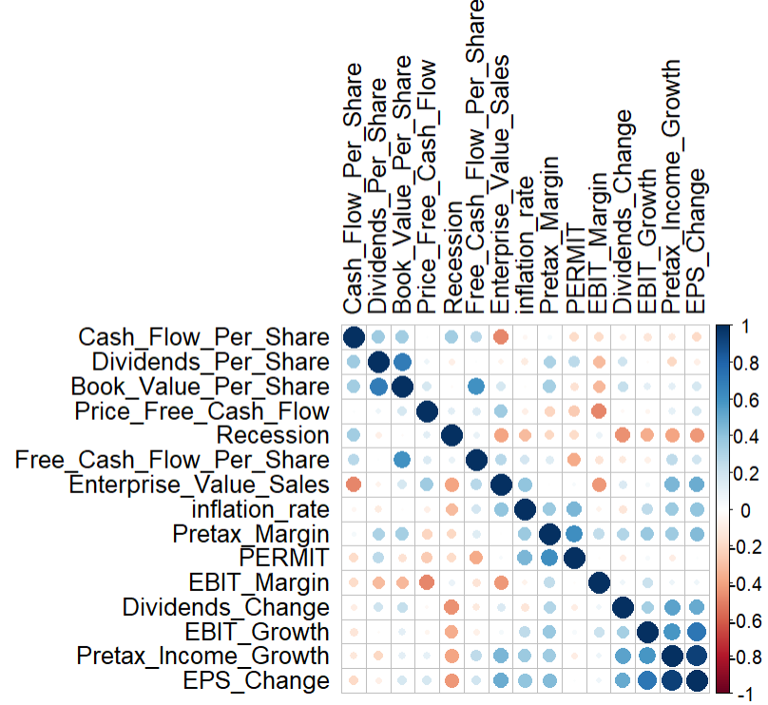
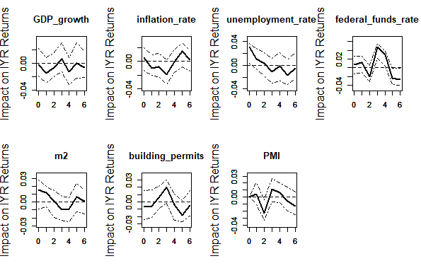
Appendix: Real Estate (EDA)
Macro plot describing the leading indicators showing effect on the sector.
Correlation plot with cut off 0.7
Notes:
Macro Plot
In this plot, we can see the effects of 7 different macroeconomic leading indicators on the Real Estate sector ETF. This has been determined through the data from the ETF data on Yahoo Finance. We can determine from the plot that the variables that highly affect this ETF are:
Federal funds rate
Building Permits
These 2 variables are used to determine the difference in forecasts and whether they help in improving the earnings forecast or not.
Corrplot
The correlation plot shows the variables that do not have more than an absolute value of 0.7 as the correlation coefficient. A combination of these variables are used for the modelling.

Slide 48
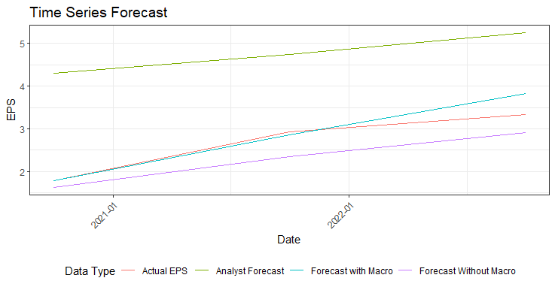
Appendix: Real Estate (Modeling)
With Macro |  |  |  |  |  |  |  |  |  | Without Macro |  |  |  |  |  |  |  |  |  | Forecasts of analysts
In Sample Accuracy |  |  |  |  | Out of Sample Accuracy |  |  |  |  | In Sample Accuracy |  |  |  |  | Out of Sample Accuracy
CV | AIC | AICc | BIC | AdjR2 | ME | RMSE | MAE | MPE | MAPE | CV | AIC | AICc | BIC | AdjR2 | ME | RMSE | MAE | MPE | MAPE | ME | RMSE | MAE | MPE | MAPE
0.694 | -67.304 | 204.696 | -52.193 | 0.639 | -0.141 | 0.284 | 0.185 | -4.094932 | 5.650 | 1.910 | -71.693 | 1.107 | -59.416 | 0.775 | 0.393 | 0.429 | 0.393 | 13.991 | 13.991 | -2.078 | 2.101 | 2.078 | -86.331 | 86.331
Notes:
This graph shows the earnings per share of firms in the Real Estate sector from 2020 to 2022 along with the relationship between the different metrics which are:
The actual EPS data which is shown by the red line
The forecasts of the analysts which are shown by the green line
Our forecasts by including the macroeconomic indicators in the model which is shown by the blue line
Our forecasts by excluding the macroeconomic indicators in the model which is shown by the purple line
The table below shows the in-sample and out-of-sample accuracy of the model with the macroeconomic data and without macroeconomic data. We have the out-of-sample accuracy for the forecasts of the analyst. We have calculated these measures with respect to the actual EPS data to see how closely we have modeled the data.
Through this graph and the table, we can see that our model with macroeconomic variables is performing better than the model without macroeconomic factors and also the forecasts of the analysts. They show a lower mean error and RMSE as well while comparing it to the actual EPS data.

Slide 49
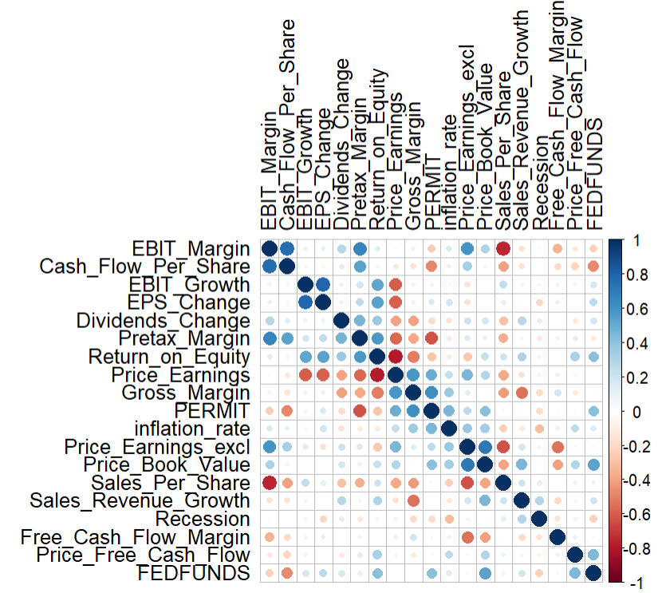
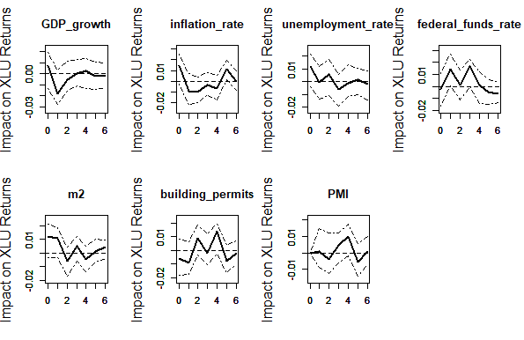
Appendix: Utilities (EDA)
Macro plot describing the leading indicators showing effect on the sector.
Correlation plot with cut off 0.8
Notes:
Macro Plot
In this plot, we can see the effects of 7 different macroeconomic leading indicators on the Utilities sector ETF. This has been determined through the data from the ETF data on Yahoo Finance. We can determine from the plot that the variables that highly affect this ETF are:
Federal funds rate
Building Permits
These 2 variables are used to determine the difference in forecasts and whether they help in improving the earnings forecast or not.
Corrplot
The correlation plot shows the variables that do not have more than an absolute value of 0.8 as the correlation coefficient. A combination of these variables are used for the modelling.

Slide 50
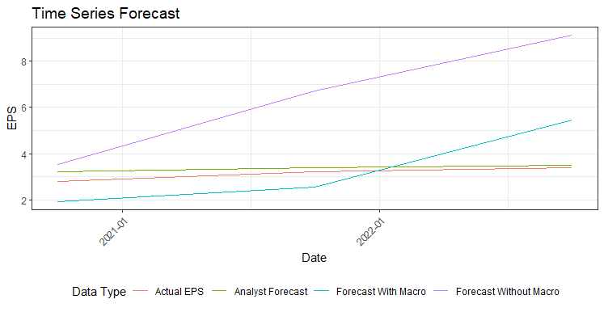
Appendix: Utilities (Modeling)
With Macro |  |  |  |  |  |  |  |  |  | Without Macro |  |  |  |  |  |  |  |  |  | Forecasts of analysts
In Sample Accuracy |  |  |  |  | Out of Sample Accuracy |  |  |  |  | In Sample Accuracy |  |  |  |  | Out of Sample Accuracy
CV | AIC | AICc | BIC | AdjR2 | ME | RMSE | MAE | MPE | MAPE | CV | AIC | AICc | BIC | AdjR2 | ME | RMSE | MAE | MPE | MAPE | ME | RMSE | MAE | MPE | MAPE
0.070 | -90.711 | 181.289 | -75.600 | 0.927 | -0.168 | 1.345 | 1.200 | -2.691049 | 37.517 | 0.067 | -86.127 | 18.873 | -72.905 | 0.924 | -3.363 | 3.950 | 3.363 | -102.527 | 102.527 | -0.237 | 0.273 | 0.237 | -7.957 | 7.957
Notes:
This graph shows the earnings per share of firms in the Utilities sector from 2020 to 2022 along with the relationship between the different metrics which are:
The actual EPS data which is shown by the red line
The forecasts of the analysts which are shown by the green line
Our forecasts by including the macroeconomic indicators in the model which is shown by the blue line
Our forecasts by excluding the macroeconomic indicators in the model which is shown by the purple line
The table below shows the in-sample and out-of-sample accuracy of the model with the macroeconomic data and without macroeconomic data. We have the out-of-sample accuracy for the forecasts of the analyst. We have calculated these measures with respect to the actual EPS data to see how closely we have modeled the data.
Through this graph and the table, we can see that our model with macroeconomic variables is performing better than the model without macroeconomic factors but it is almost comparable or less comparable than the forecasts of the analysts. They show a lower mean error and RMSE as well while comparing it to the actual EPS data.

Slide 51
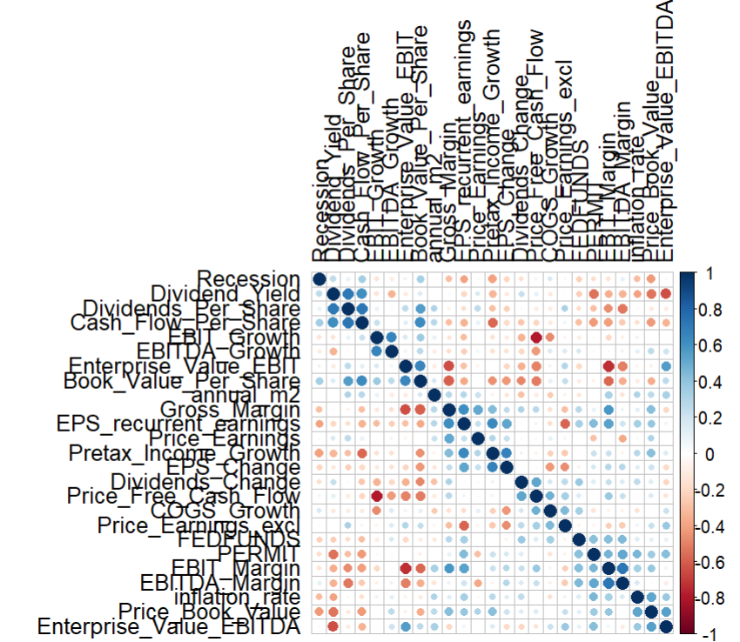
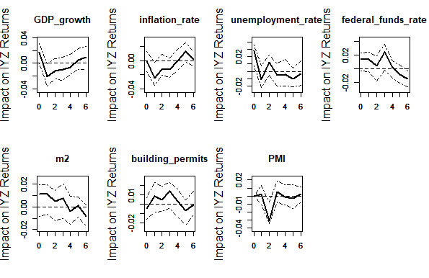
Appendix: Telecommunication (EDA)
Macro plot describing the leading indicators showing effect on the sector.
Correlation plot with cut off 0.8
Notes:
Macro Plot
In this plot, we can see the effects of 7 different macroeconomic leading indicators on the Telecommunication sector ETF. This has been determined through the data from the ETF data on Yahoo Finance. We can determine from the plot that the variables that highly effect this ETF are:
Federal funds rate
Money Stock (m2)
Building Permits
These 3 variables are used to determine the difference in forecasts and whether they help in improving the earnings forecast or not.
Corrplot
The correlation plot shows the variables that do not have more than an absolute value of 0.8 as the correlation coefficient. A combination of these variables are used for the modelling.

Slide 52
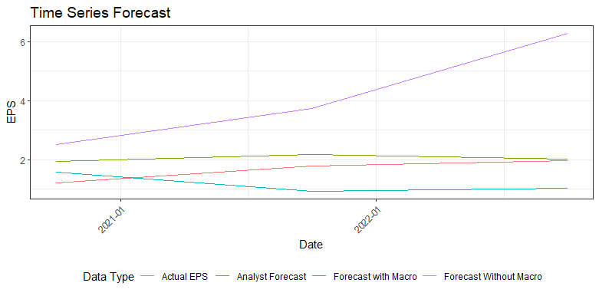
Appendix: Telecommunication (Modeling)
With Macro |  |  |  |  |  |  |  |  |  | Without Macro |  |  |  |  |  |  |  |  |  | Forecasts of analysts
In Sample Accuracy |  |  |  |  | Out of Sample Accuracy |  |  |  |  | In Sample Accuracy |  |  |  |  | Out of Sample Accuracy
CV | AIC | AICc | BIC | AdjR2 | ME | RMSE | MAE | MPE | MAPE | CV | AIC | AICc | BIC | AdjR2 | ME | RMSE | MAE | MPE | MAPE | ME | RMSE | MAE | MPE | MAPE
39.412 | -2.043 | 102.957 | 11.179 | 0.842 | 0.471 | 0.756 | 0.714 | 21.518 | 41.477 | 4.040 | -6.379 | 31.335 | 4.010 | 0.885 | -2.518 | 2.828 | 2.518 | -144.648 | 144.648 | -0.396 | 0.484 | 0.396 | -28.467 | 28.467
Notes:
This graph shows the earnings per share of firms in the Telecommunication sector from 2020 to 2022 along with the relationship between the different metrics which are:
The actual EPS data which is shown by the red line
The forecasts of the analysts which are shown by the green line
Our forecasts by including the macroeconomic indicators in the model which is shown by the blue line
Our forecasts by excluding the macroeconomic indicators in the model which is shown by the purple line
The table below shows the in-sample and out-of-sample accuracy of the model with the macroeconomic data and without macroeconomic data. We have the out-of-sample accuracy for the forecasts of the analyst. We have calculated these measures with respect to the actual EPS data to see how closely we have modeled the data.
Through this graph and the table, we can see that our model with macroeconomic variables is performing better than the model without macroeconomic factors but it is almost comparable or less comparable than the forecasts of the analysts. They show a lower mean error and RMSE as well while comparing it to the actual EPS data.

Slide 53
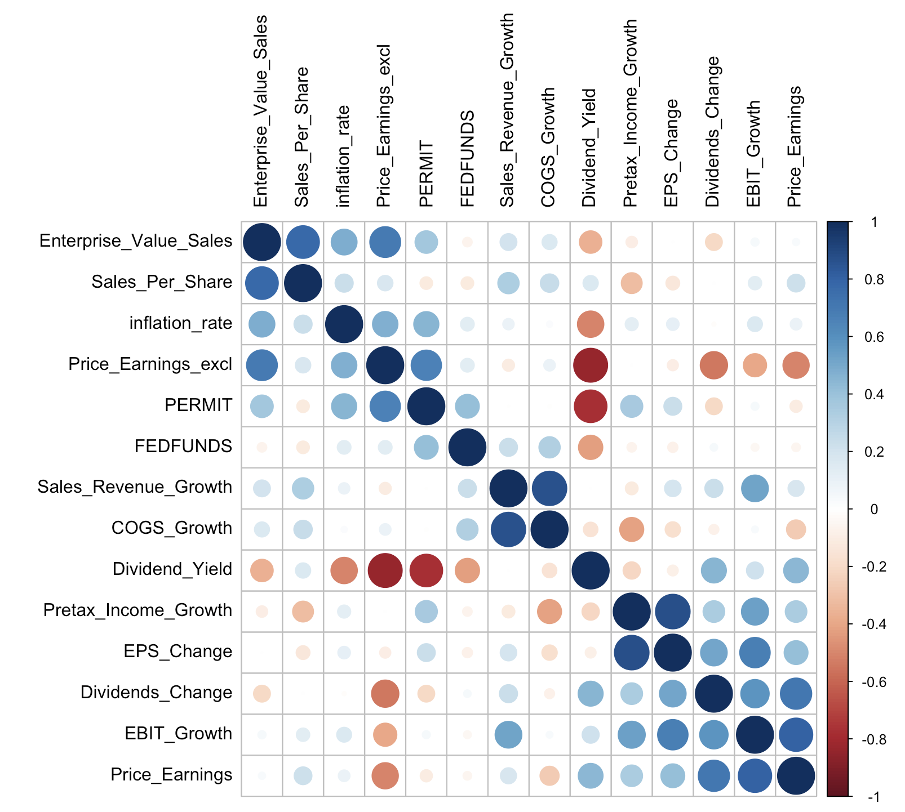
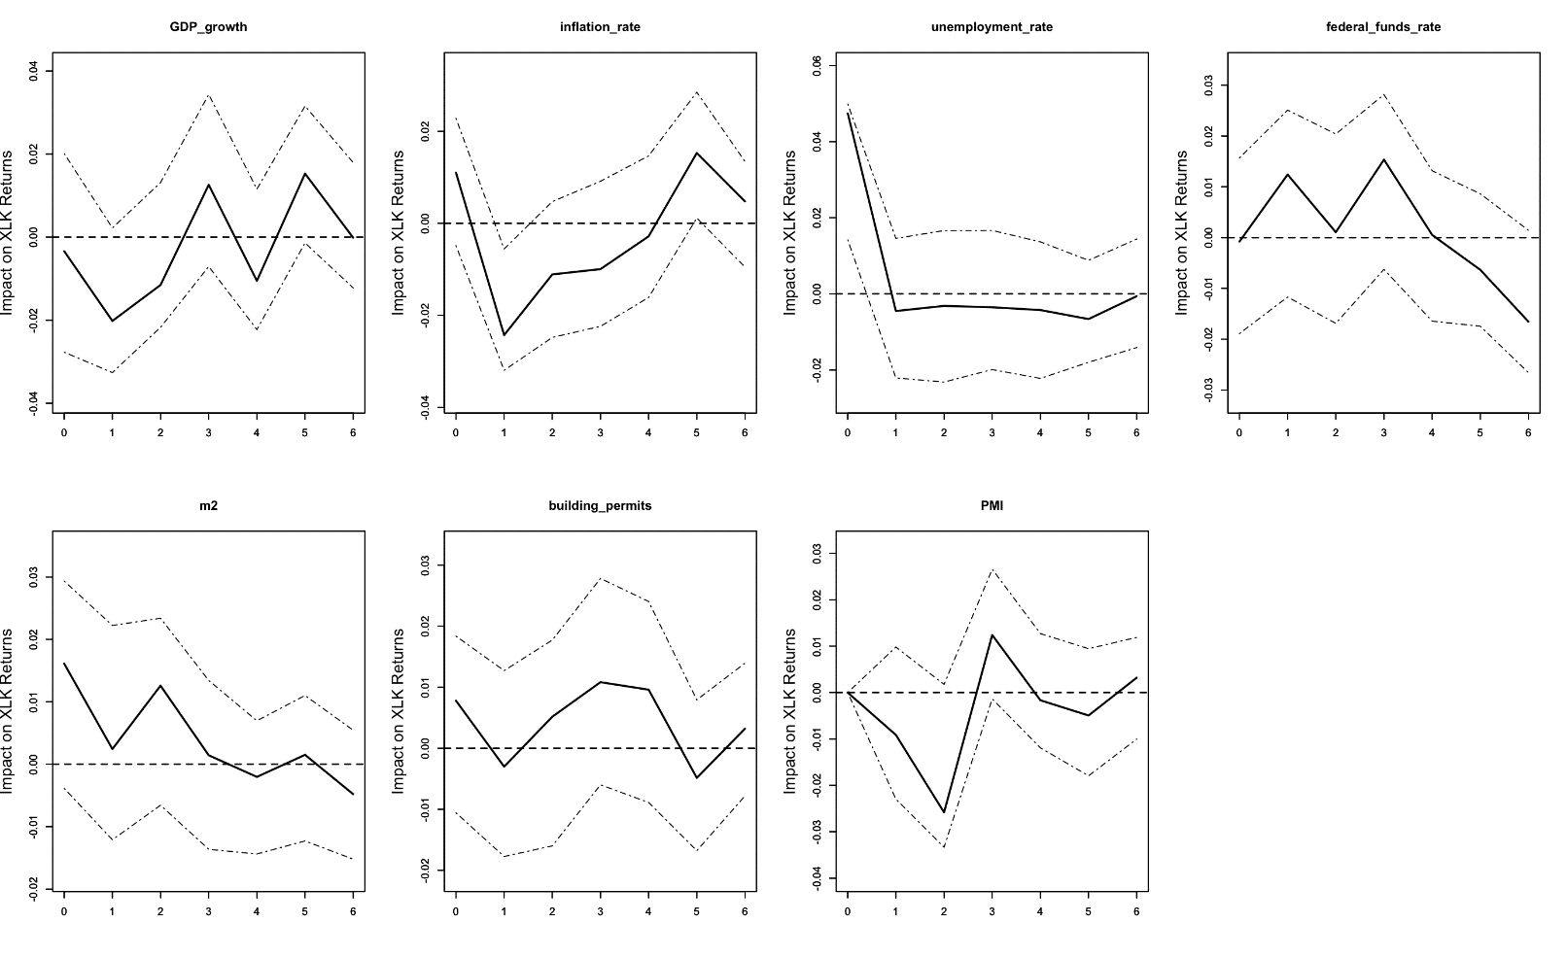
Appendix: Information Technology (EDA)
Macro plot describing the leading indicators showing the effect on the sector.
Correlation plot with cut-off 0.7
Notes:
Macro Plot
In this plot, we can see the effects of 7 different macroeconomic leading indicators on the Technology sector ETF. This has been determined through the data from the ETF data on Yahoo Finance. We can determine from the plot that the variables that highly effect this ETF are:
Federal funds rate
Money Stock (m2)
Building Permits
These 3 variables are used to determine the difference in forecasts and whether they help in improving the earnings forecast or not.
Corrplot
The correlation plot shows the variables that do not have more than an absolute value of 0.7 as the correlation coefficient. A combination of these variables are used for the modelling.

Slide 54
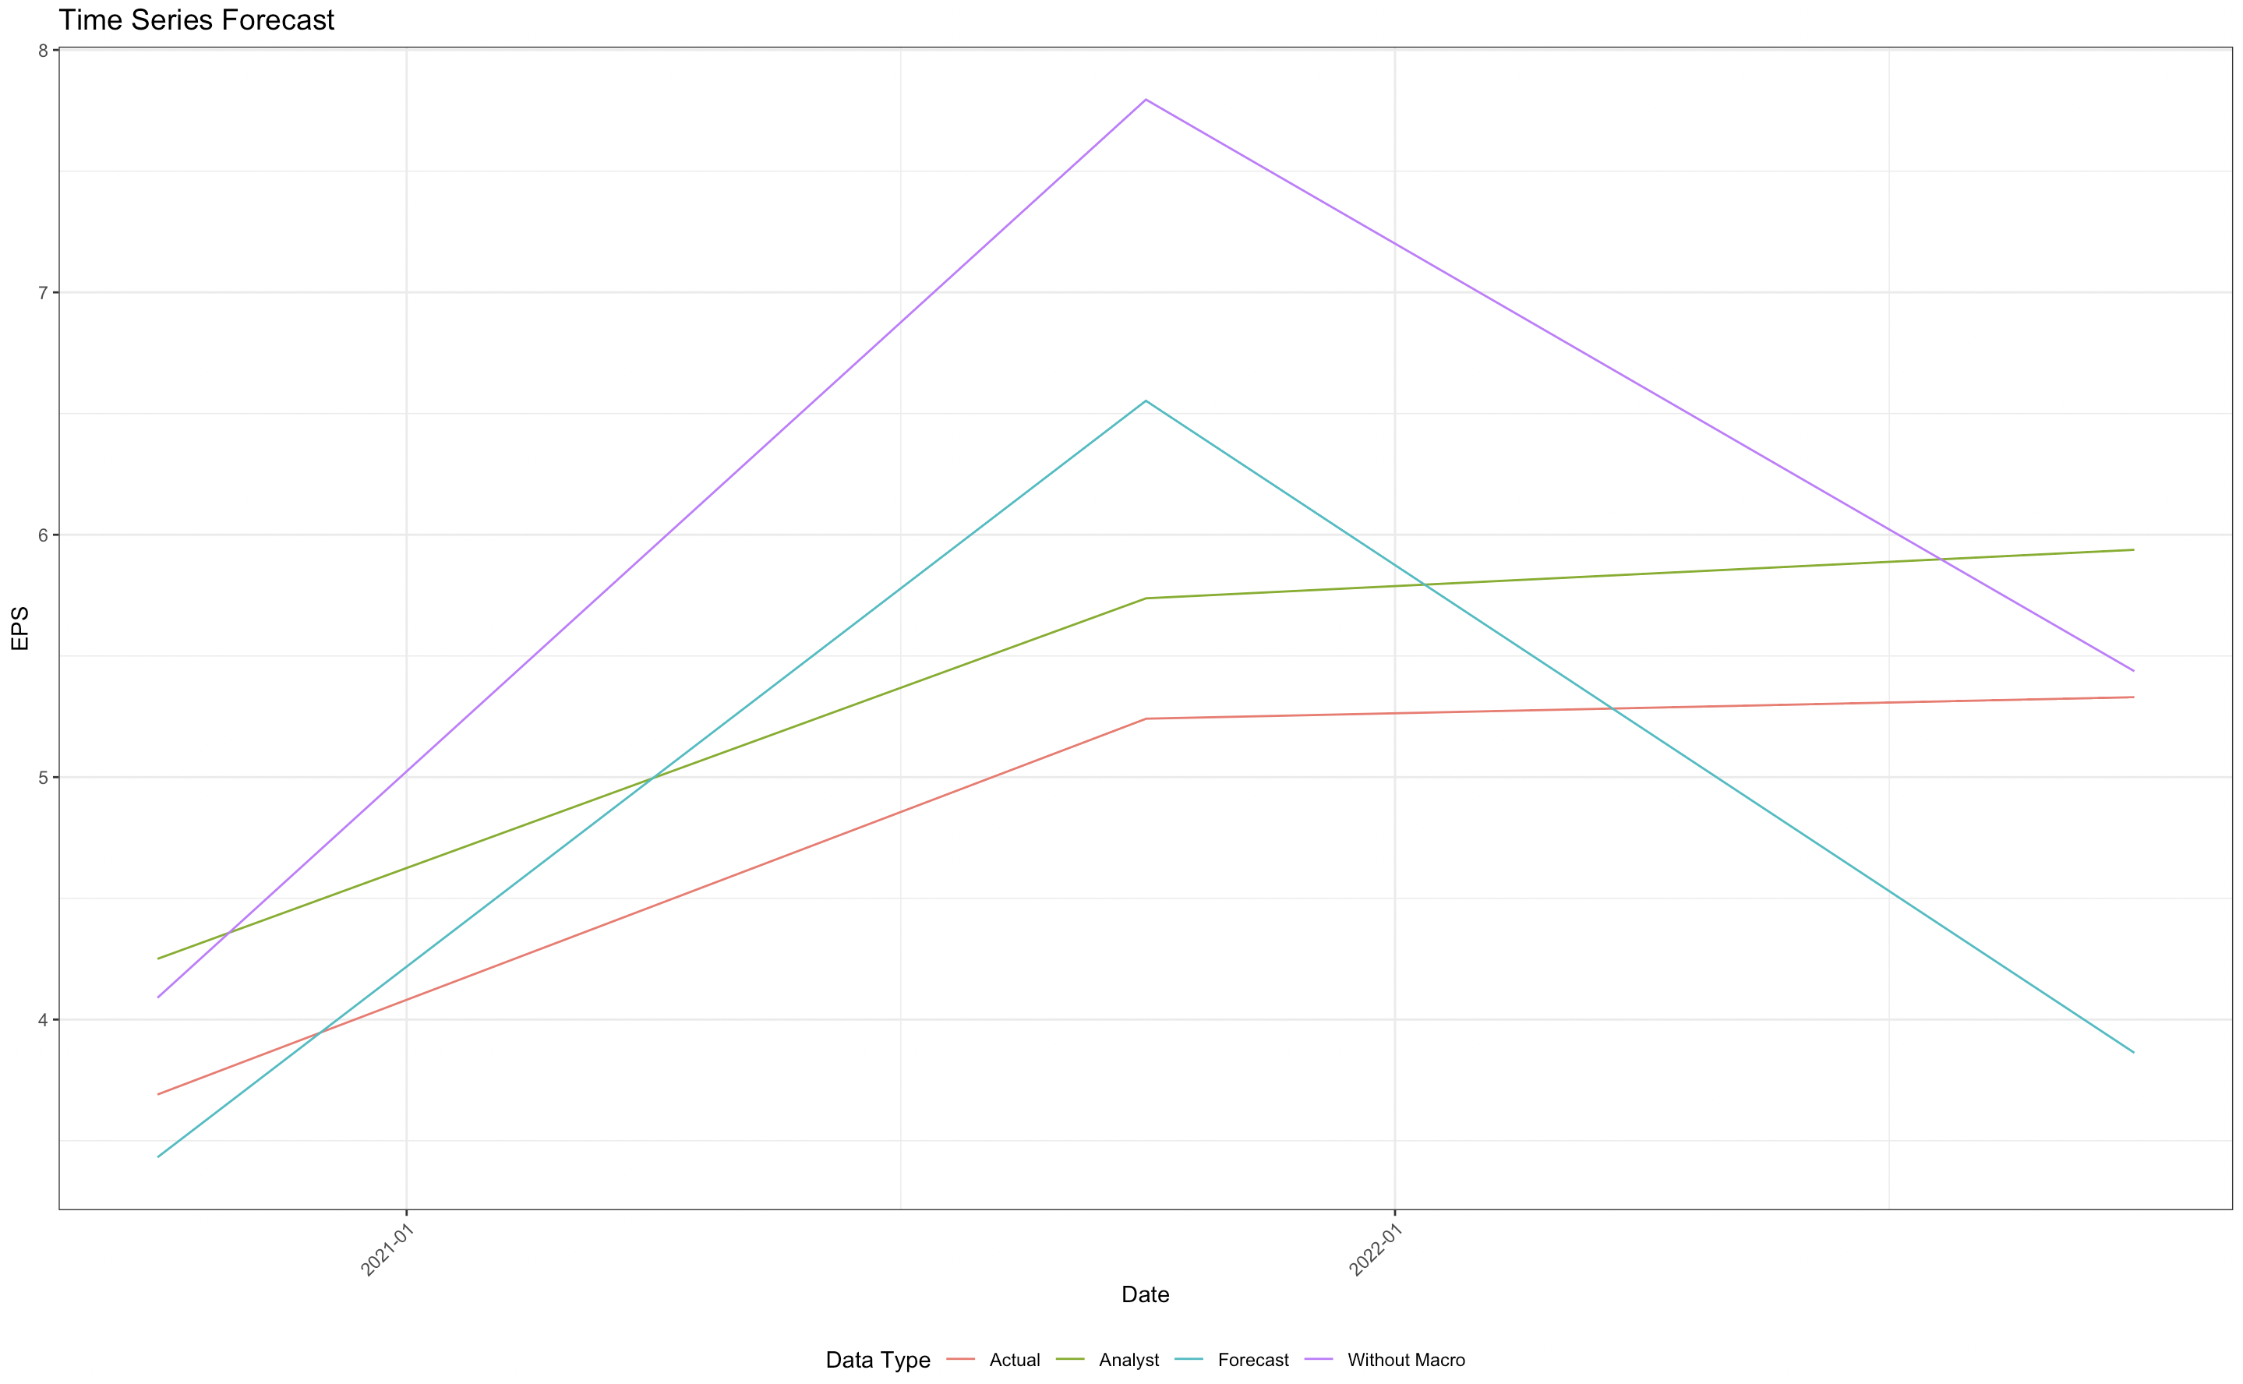
Appendix: Information Technology (Modeling)
With Macro |  |  |  |  |  |  |  |  |  | Without Macro |  |  |  |  |  |  |  |  |  | Forecasts of analysts
In Sample Accuracy |  |  |  |  | Out of Sample Accuracy |  |  |  |  | In Sample Accuracy |  |  |  |  | Out of Sample Accuracy
CV | AIC | AICc | BIC | AdjR2 | ME | RMSE | MAE | MPE | MAPE | CV | AIC | AICc | BIC | AdjR2 | ME | RMSE | MAE | MPE | MAPE | ME | RMSE | MAE | MPE | MAPE
7.48 | -74.748 | -1.948 | -62.471 | 0.972 | 0.138 | 1.146 | 1.012 | 3.173 | 19.861 | 10.749 | -65.406 | -13.406 | -54.073 | 0.956 | -1.02 | 1.493 | 1.02 | -20.516 | 20.516 | -0.554 | 0.556 | 0.554 | -12.013 | 12.013
Notes:
This graph shows the earnings per share of firms in the Information Technology sector from 2020 to 2022 along with the relationship between the different metrics which are:
The actual EPS data which is shown by the red line
The forecasts of the analysts which are shown by the green line
Our forecasts by including the macroeconomic indicators in the model which is shown by the blue line
Our forecasts by excluding the macroeconomic indicators in the model which is shown by the purple line
The table below shows the in-sample and out-of-sample accuracy of the model with the macroeconomic data and without macroeconomic data. We have the out-of-sample accuracy for the forecasts of the analyst. We have calculated these measures with respect to the actual EPS data to see how closely we have modeled the data.
Through this graph and the table, we can see that our model with macroeconomic variables is performing better than the model without macroeconomic factors and also the forecasts of the analysts. They show a lower mean error while comparing it to the actual EPS data.

Slide 55
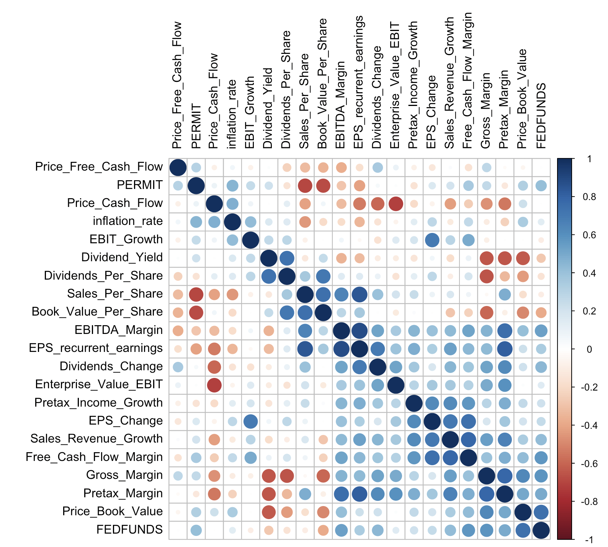
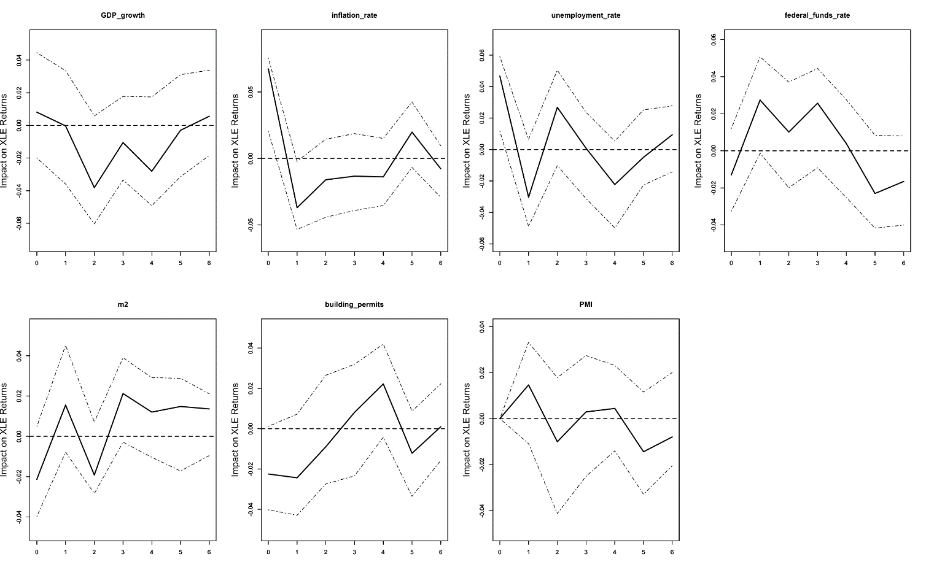
Appendix: Energy (EDA)
Macro plot describing the leading indicators showing the effect on the sector.
Correlation plot with cut-off 0.7
Notes:
Macro Plot
In this plot, we can see the effects of 7 different macroeconomic leading indicators on the Energy sector ETF. This has been determined through the data from the ETF data on Yahoo Finance. We can determine from the plot that the variables that highly effect this ETF are:
Federal funds rate
Building Permits
These 2 variables are used to determine the difference in forecasts and whether they help in improving the earnings forecast or not.
Corrplot
The correlation plot shows the variables that do not have more than an absolute value of 0.7 as the correlation coefficient. A combination of these variables are used for the modelling.

Slide 56
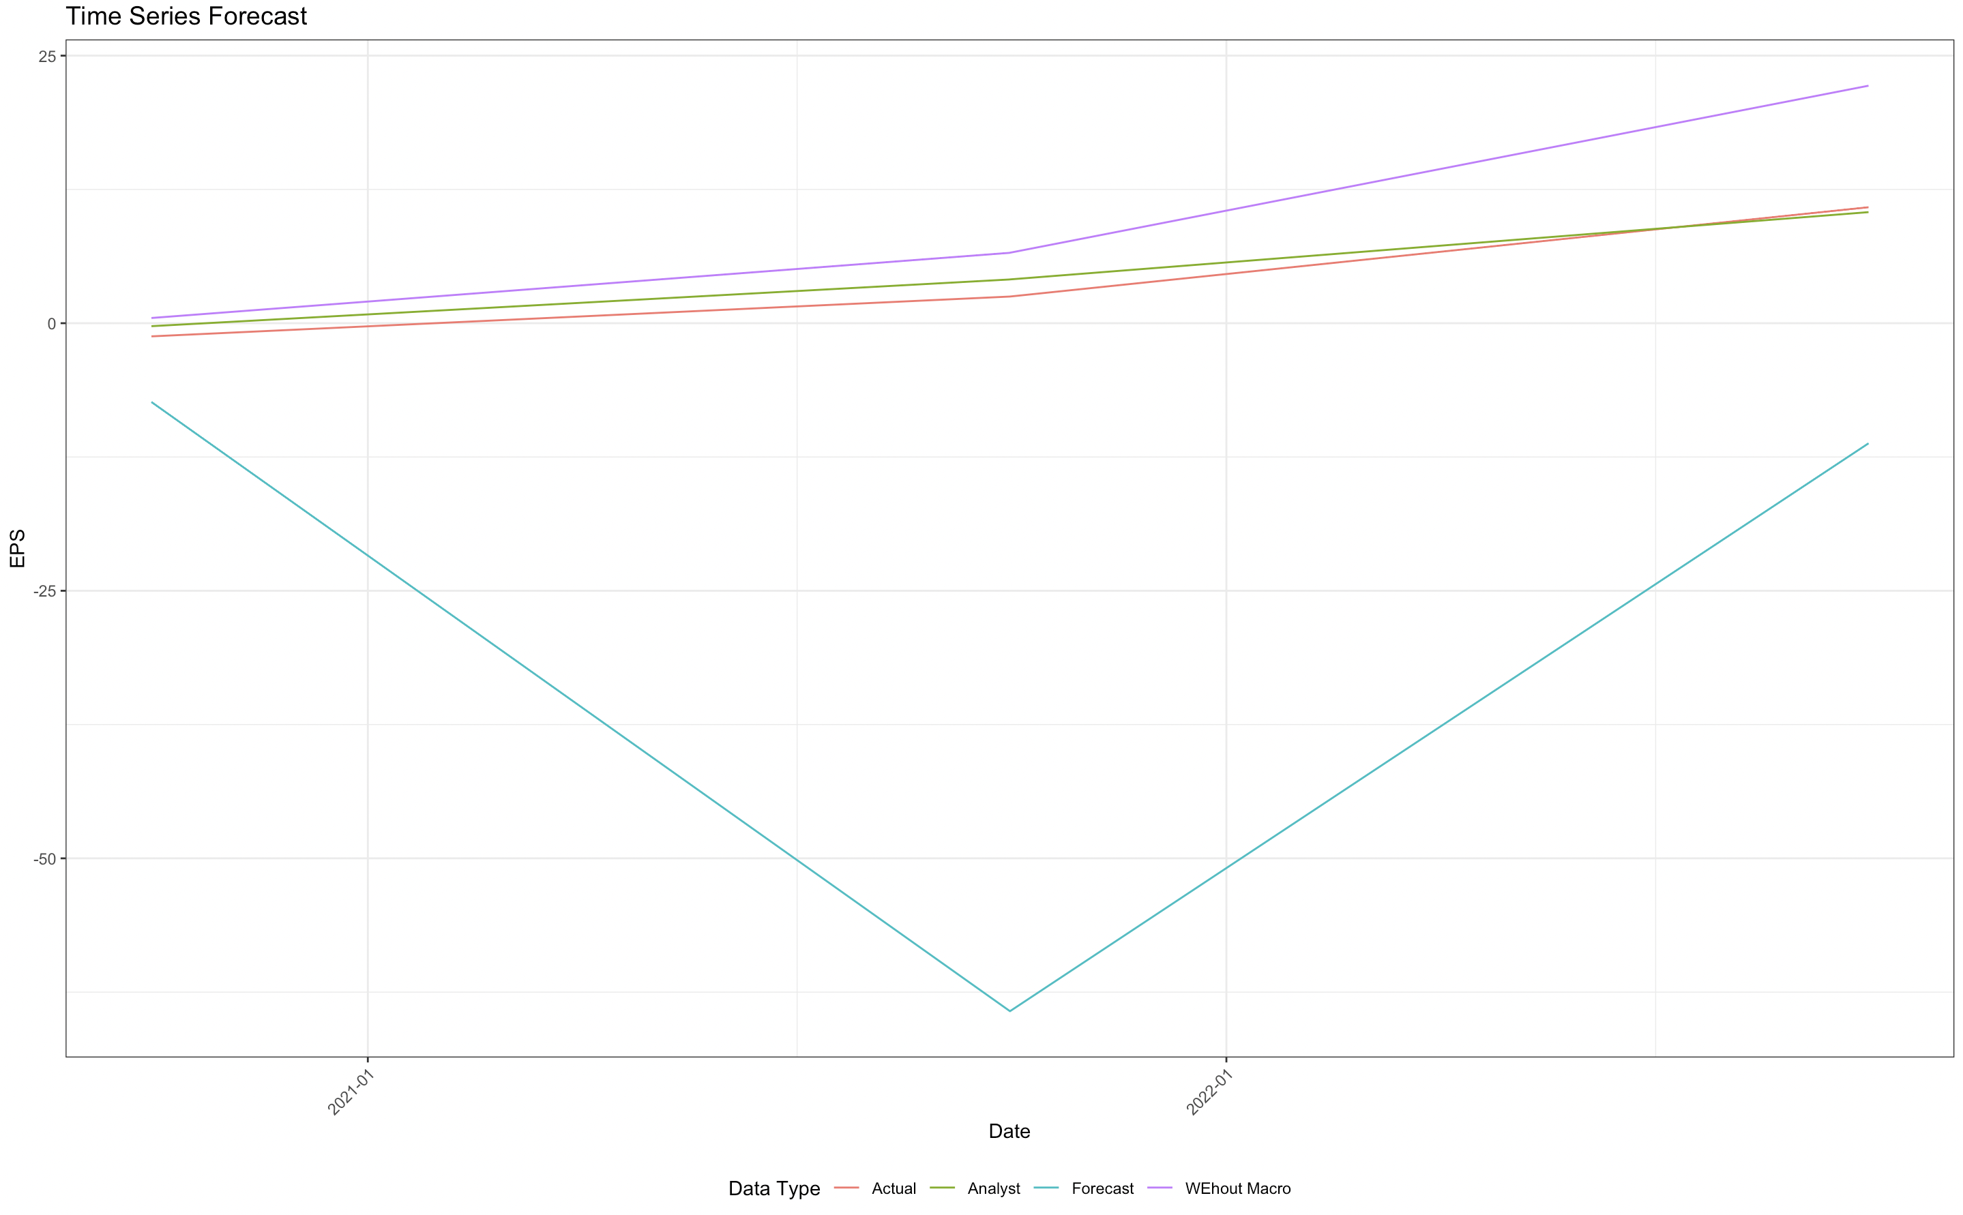
Appendix: Energy (Modeling)
With Macro |  |  |  |  |  |  |  |  |  | Without Macro |  |  |  |  |  |  |  |  |  | Forecasts of analysts
In Sample Accuracy |  |  |  |  | Out of Sample Accuracy |  |  |  |  | In Sample Accuracy |  |  |  |  | Out of Sample Accuracy
CV | AIC | AICc | BIC | AdjR2 | ME | RMSE | MAE | MPE | MAPE | CV | AIC | AICc | BIC | AdjR2 | ME | RMSE | MAE | MPE | MAPE | ME | RMSE | MAE | MPE | MAPE
61.148 | -96.626 | -1108.626 | -72.623 | 0.981 | 31.656 | 40.756 | 31.656 | 794.634 | 1127.233 | 1.612 | -21.016 | 6.483 | -11.571 | 0.815 | -5.717 | 7.031 | 5.717 | -43.029 | 136.181 | -0.694 | 1.108 | 1.007 | 5.843 | 48.666
Notes:
This graph shows the earnings per share of firms in the Energy sector from 2020 to 2022 along with the relationship between the different metrics which are:
The actual EPS data which is shown by the red line
The forecasts of the analysts which are shown by the green line
Our forecasts by including the macroeconomic indicators in the model which is shown by the blue line
Our forecasts by excluding the macroeconomic indicators in the model which is shown by the purple line
The table below shows the in-sample and out-of-sample accuracy of the model with the macroeconomic data and without macroeconomic data. We have the out-of-sample accuracy for the forecasts of the analyst. We have calculated these measures with respect to the actual EPS data to see how closely we have modeled the data.
Through this graph and the table, we can see that our model with macroeconomic variables is not performing better than the model without macroeconomic factors or the forecasts of the analysts. They show a higher mean error while comparing it to the actual EPS data.

Slide 57
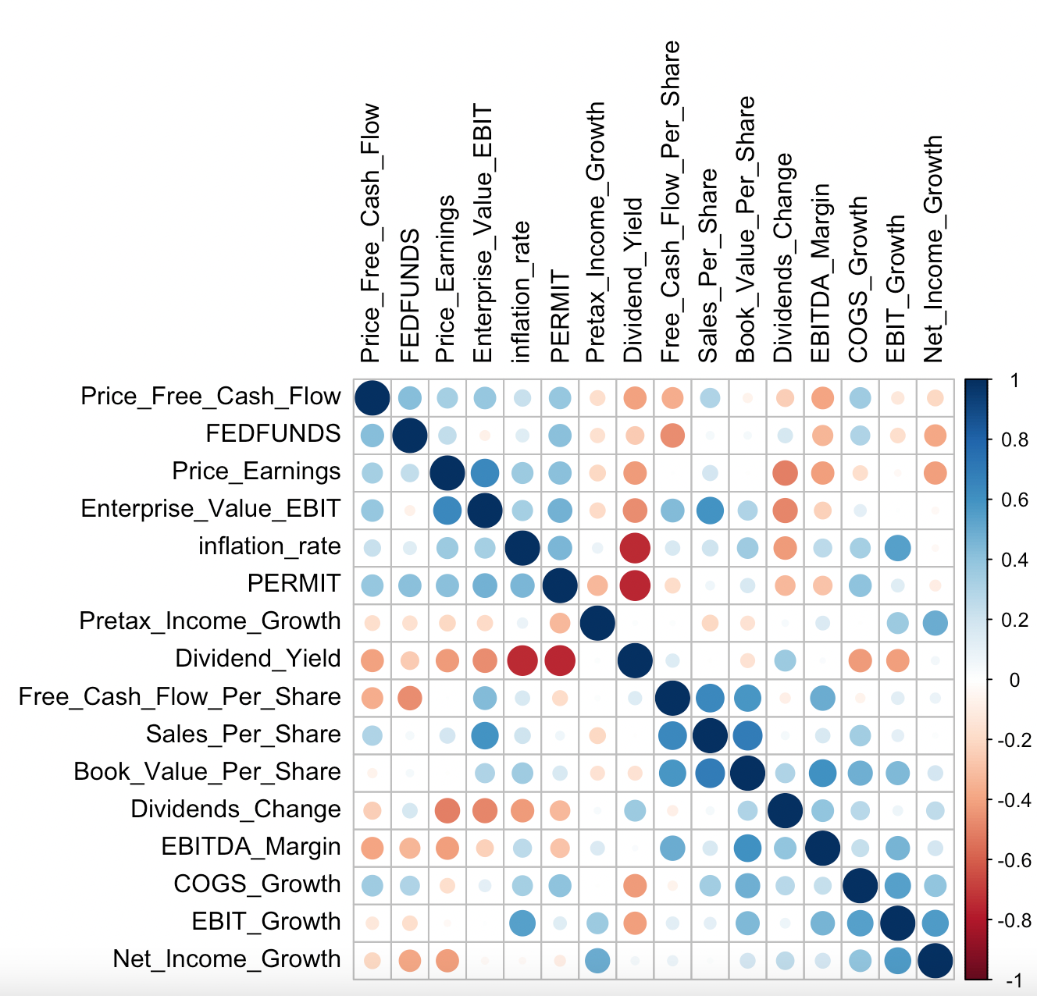
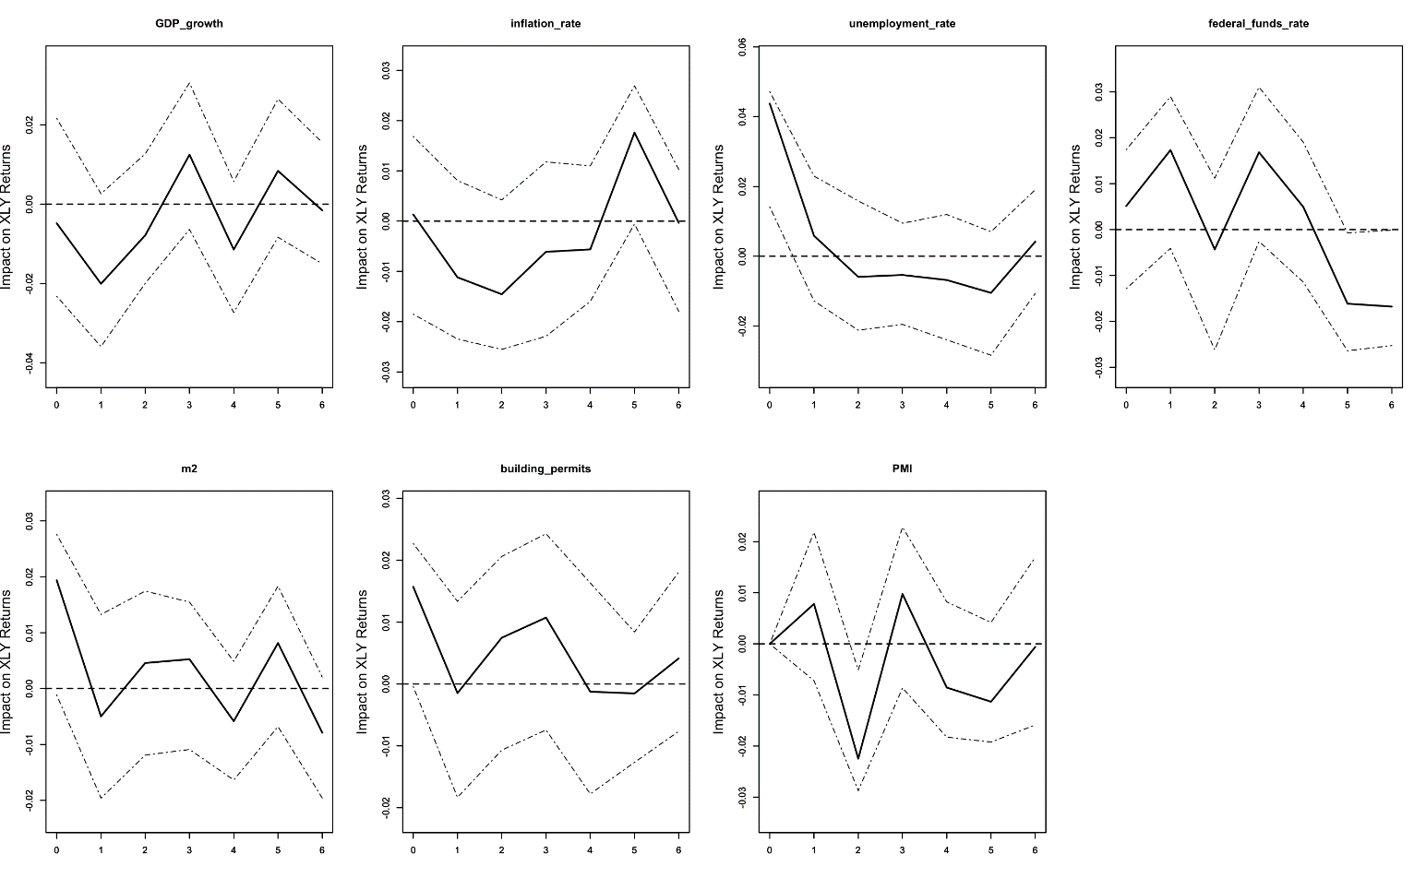
Appendix: Consumer Discretionary (EDA)
Macro plot describing the leading indicators showing the effect on the sector.
Correlation plot with cut-off 0.7
Notes:
Macro Plot
In this plot, we can see the effects of 7 different macroeconomic leading indicators on the Consumer sector ETF. This has been determined through the data from the ETF data on Yahoo Finance. We can determine from the plot that the variables that highly effect this ETF are:
Federal funds rate
Building Permits
These 2 variables are used to determine the difference in forecasts and whether they help in improving the earnings forecast or not.
Corrplot
The correlation plot shows the variables that do not have more than an absolute value of 0.7 as the correlation coefficient. A combination of these variables are used for the modelling.

Slide 58
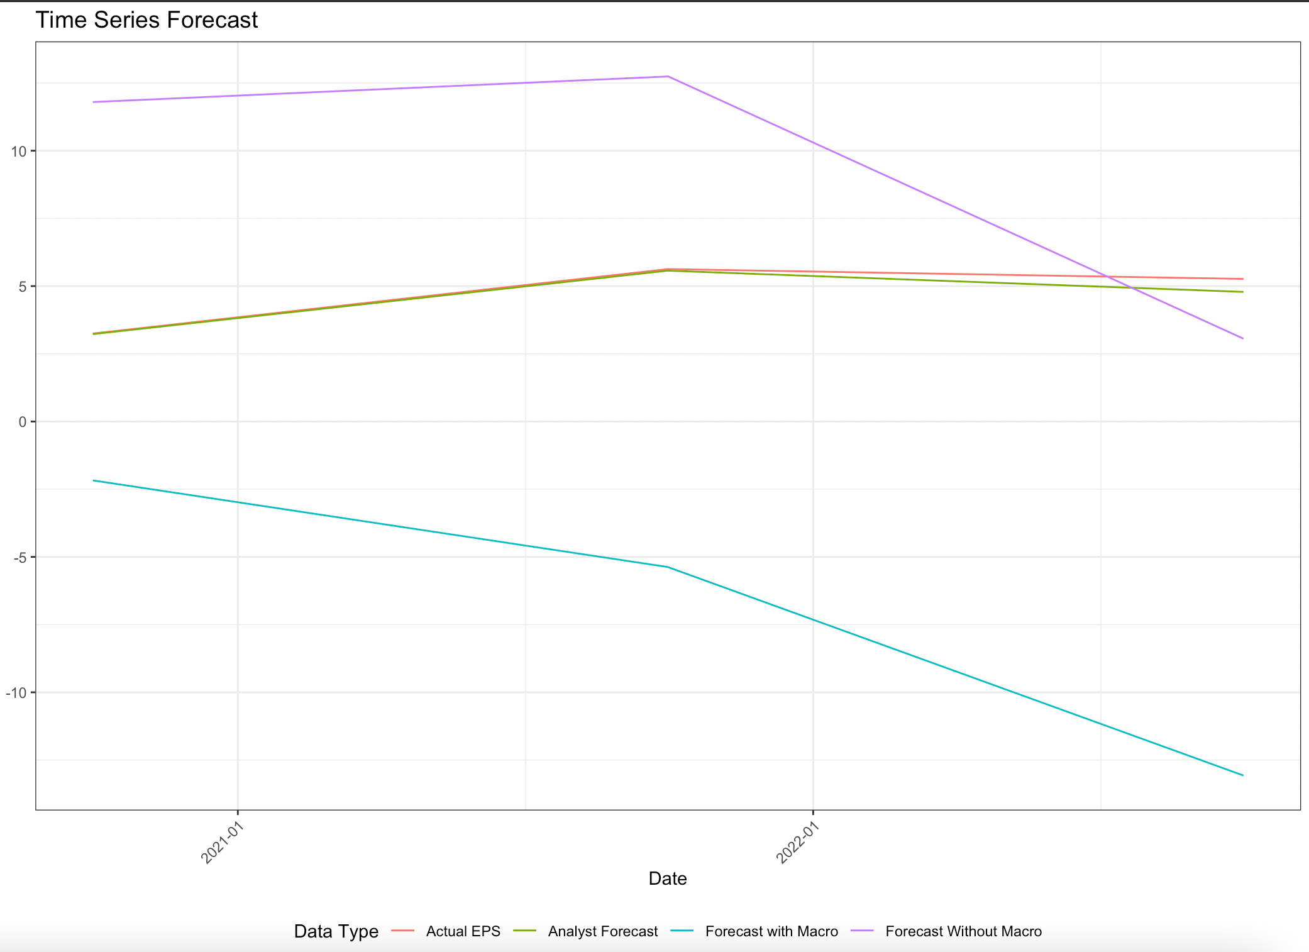
Appendix: Consumer Discretionary (TSLM Model)
With Macro |  |  |  |  |  |  |  |  |  | Without Macro |  |  |  |  |  |  |  |  |  | Forecasts of analysts
In Sample Accuracy |  |  |  |  | Out of Sample Accuracy |  |  |  |  | In Sample Accuracy |  |  |  |  | Out of Sample Accuracy
CV | AIC | AICc | BIC | AdjR2 | ME | RMSE | MAE | MPE | MAPE | CV | AIC | AICc | BIC | AdjR2 | ME | RMSE | MAE | MPE | MAPE | ME | RMSE | MAE | MPE | MAPE
7.152 | -73.94 | 56.086 | -59.775 | 0.879 | 11.589 | 12.739 | 11.589 | 236.858 | 236.858 | 131.211 | -52.782 | -0.782 | -41.448 | 0.684 | -4.816 | 6.546 | 5.957 | -115.857 | 143.816 | 0.186 | 0.279 | 0.186 | 3.59 | 3.59
Notes:
This graph shows the earnings per share of firms in the Consumer Discretionary sector from 2020 to 2022 along with the relationship between the different metrics which are:
The actual EPS data which is shown by the red line
The forecasts of the analysts which are shown by the green line
Our forecasts by including the macroeconomic indicators in the model which is shown by the blue line
Our forecasts by excluding the macroeconomic indicators in the model which is shown by the purple line
The table below shows the in-sample and out-of-sample accuracy of the model with the macroeconomic data and without macroeconomic data. We have the out-of-sample accuracy for the forecasts of the analyst. We have calculated these measures with respect to the actual EPS data to see how closely we have modeled the data.
Through this graph and the table, we can see that our model with macroeconomic variables is not performing better than the model without macroeconomic factors or the forecasts of the analysts. They show a higher mean error while comparing it to the actual EPS data.

Slide 59
Appendix: Consumer Discretionary (tslm VS dynlm Model)
Notes:
The graph is the results of dynamic linear regression model for Healthcare Sector, and on the right it’s the Consumer Discretionary Sector. As you can see in this graph, it shows the EPS change of sectors from 2020 Q1 to 2023 Q1 along with the relationship between the different metrics which are:
The real data (EPS change) is shown by purple line
The previous TSLM model’s forecast is shown by blue line
The new DYNLM model’s forecast without marco data is shown by green line.
The new DYNLM model’s forecast with macro data is shown by red line.
We can get the conclusion just from this graph that the DYNLM model has a good forecast of EPS_Change on trend with the actual data. DYNLM model works better than the previous TSLM model with a lower mean absolute error. Also, model without the macro data predicts better than model with macro data, which means we may not find the most suitable macro indicators in Consumer Discretionary Sector.

Slide 60
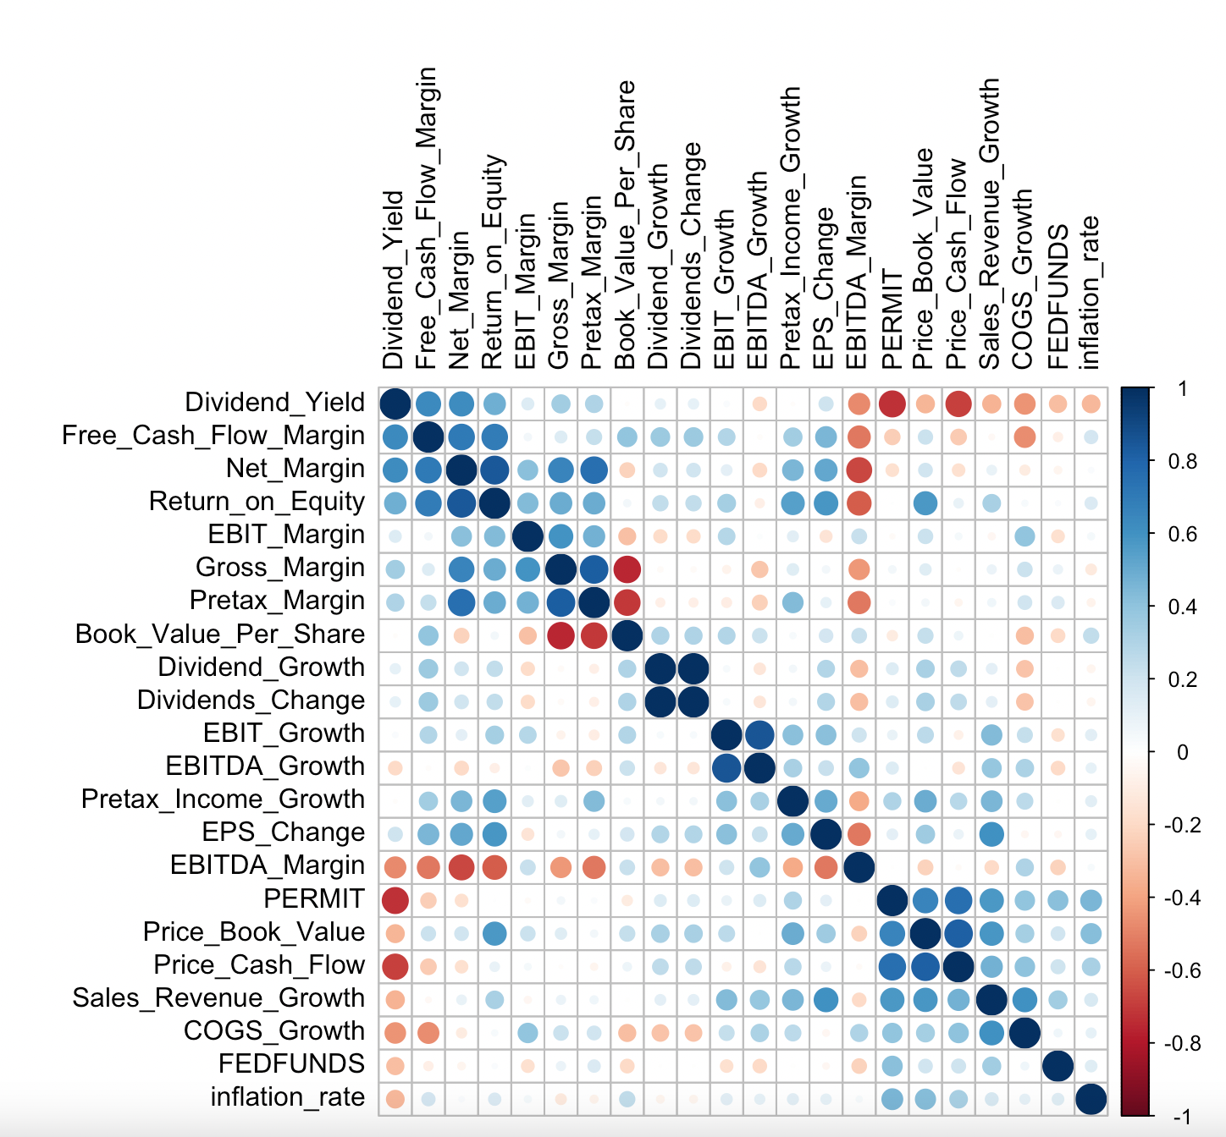
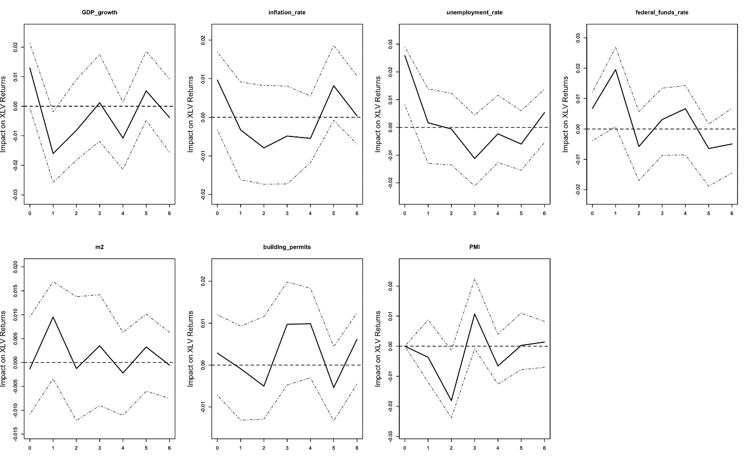
Appendix: Healthcare (EDA)
Macro plot describing the leading indicators showing the effect on the sector.
Correlation plot with cut-off 0.7
Notes:
Macro Plot
In this plot, we can see the effects of 7 different macroeconomic leading indicators on the Healthcare sector ETF. This has been determined through the data from the ETF data on Yahoo Finance. We can determine from the plot that the variables that highly effect this ETF are:
Federal funds rate
Money Stock (m2)
Building Permits
These 3 variables are used to determine the difference in forecasts and whether they help in improving the earnings forecast or not.
Corrplot
The correlation plot shows the variables that do not have more than an absolute value of 0.7 as the correlation coefficient. A combination of these variables are used for the modeling.

Slide 61
Appendix: Healthcare (TSLM Model)
With Macro |  |  |  |  |  |  |  |  |  | Without Macro |  |  |  |  |  |  |  |  |  | Forecasts of analysts
In Sample Accuracy |  |  |  |  | Out of Sample Accuracy |  |  |  |  | In Sample Accuracy |  |  |  |  | Out of Sample Accuracy
CV | AIC | AICc | BIC | AdjR2 | ME | RMSE | MAE | MPE | MAPE | CV | AIC | AICc | BIC | AdjR2 | ME | RMSE | MAE | MPE | MAPE | ME | RMSE | MAE | MPE | MAPE
0.1877 | -218.772 | -978.772 | -200.827 | 0.977 | -0.969 | 1.142 | 0.968 | -22.862 | 22.862 | 0.102 | -123.5 | 488.5 | -107.445 | 0.8575 | -0.967 | 0.99 | 0.957 | -17.271 | 17.271 | -1.666 | 1.672 | 1.666 | -29.506 | 29.506
Notes:
This graph shows the earnings per share of firms in the Healthcare sector from 2020 to 2022 along with the relationship between the different metrics which are:
The actual EPS data which is shown by the red line
The forecasts of the analysts which are shown by the green line
Our forecasts by including the macroeconomic indicators in the model which is shown by the blue line
Our forecasts by excluding the macroeconomic indicators in the model which is shown by the purple line
Through this graph and the table, we can see that our model with macroeconomic variables is performing better than the forecasts of the analysts but not outperforming the model without macroeconomic factors. It shows a lower mean error and RMSE as compared to the accuracy of the model without the macro variables while comparing it to the actual EPS data.
Through this graph and the table, we can see that our model with macroeconomic variables is performing better than the model without macroeconomic factors but it is almost comparable or less comparable than the forecasts of the analysts. They show a lower mean error and RMSE as well while comparing it to the actual EPS data.

Slide 62
Appendix: Healthcare (TSLM VS DYNLM Model)
Notes:
The graph is the results of dynamic linear regression model for Healthcare Sector, and on the right it’s the Consumer Discretionary Sector. As you can see in this graph, it shows the EPS change of sectors from 2020 Q1 to 2023 Q1 along with the relationship between the different metrics which are:
The real data (EPS change) is shown by purple line
The previous TSLM model’s forecast is shown by blue line
The new DYNLM model’s forecast without marco data is shown by green line.
The new DYNLM model’s forecast with macro data is shown by red line.
We can get the conclusion just from this graph that the DYNLM model has a good forecast of EPS_Change on trend with the actual data. DYNLM model works better than the previous TSLM model with a lower mean absolute error. Also, model with the macro data predicts better than model without macro data, which means macro data works on DYNLM model.

